Slide 1
Civil Air Patrol
ADVANCED LEVEL
OPERATIONAL RISK MANAGEMENT

Slide 2
Important note!
The material in this presentation provides some worthwhile information on risk management.
However, the content is dated and does not necessarily reflect the current guidance found in CAPR 160-1 and CAPR 160-2, and should be considered informational only

Slide 3
In CAP’s Basic and Intermediate course you learned that Operational Risk Management is a logic-based, common sense approach to making calculated decisions on human, material and environmental factors associated with any type of activity. Or simply put, it’s a methodical, six-step process to manage inherent risk.
ORM does not replace regulations or allow CAP officers and cadets to disregard existing regulations. ORM fills the gap between real-world conditions and scenarios which are not already covered under regulation or law. Use of ORM does not guarantee mission success, but provides a standard methodology for avoiding or reducing mishaps.
If your have forgotten certain aspects of ORM, go back over the two previous courses before proceeding. Otherwise here is a refresher of the main points of ORM.

Slide 4
The four principles of ORM are: Accept no unnecessary risks Make risk decisions at the appropriate level Accept risk when benefits outweigh the cost Integrate ORM into CAP at all levels | The six-steps of ORM are: Identify the Hazards Assess the Risks Analyze the Risk Control Measures Make Control Decisions Implement Risk Controls Supervise and Review
The 5M Model Man Media Machine Management Mission | The three levels of ORM Time-Critical Deliberate Strategic

Slide 5
This advanced course will enhance mission success by increasing your knowledge of the ORM process with the addition of some new items.
Ten hazard identification tools are presented to guide you in uncovering areas of potential hazards as you work through ORM’s first step.
The course will also explore steps two through six in greater detail.

Slide 6
Step 1. Identify Hazards
To identify the hazards, you analyze the mission, list the hazards and list the causes.
Perform hazard ID on all of CAP’s assets:
Aircraft
Vehicles
Personnel
Equipment
Apply hazard ID to all operational levels:
National
Region
Wing
Group
Squadron & Flights

Slide 7
Step 1. Identify Hazards
These seven primary tools are the backbone in identifying hazards in any CAP operation.
The Seven Primary Hazard ID Tools:
Operations Analysis
Preliminary Hazard Analysis
“What If” Tool
Scenario Process Tool
Logic Diagram
Change Analysis
Cause & Effect Tool

Slide 8
Step 1. Identify Hazards Operations Analysis Tool
Used mostly by planners.
Big picture look at what is expected to happen.
Evaluates all elements of operation for potential sources of risk.
Overcomes focusing on only a few intuitively identified risky operational areas.
Itemizes chronological or sequential list of major events of an operation.
Key to understanding which event(s) pose the highest level of risk.
Each event can be broken down into sub-events.

Slide 9
Step 1. Identify Hazards Operations Analysis Tool
Key to understanding flow of events.
Overcomes major weakness of only focusing on a few intuitively identified risky operational areas.
Pen & Paper: Put steps of process on index cards or “sticky” notes.
Can rearrange as necessary.
Easily add or eliminate areas or events.
Computer: Use project management software or create simple flow chart.

Slide 10
Step 1. Identify Hazards Preliminary Hazard Analysis Tool
Provides initial or broad overview of hazards present in overall operational flow.
Briefly considers risk in every aspect.
Can serve as only hazard ID tool if risk is low or routine.
In higher risk operations, used to focus and prioritize risk issues.
Used in virtually all ORM except time critical operations.
Usually based on the operational analysis tool results

Slide 11
Step 1. Identify Hazards Preliminary Hazard Analysis Tool
Used to identify hazards requiring more in-depth hazard ID
Easy to use and takes very little time
Activity or Event | Hazard
Step 1 | Hazard 1 Hazard 2
Step 2 | Hazard 1
Step 3 | Hazard 1 Hazard 2

Slide 12
Step 1. Identify Hazards “What If” Tool
One of the most powerful hazards ID tools.
Designed to add structure to the intuitive and experiential expertise of operational personnel.
Especially effective in capturing hazard data about failure modes.
Typically used after the operations analysis and preliminary hazard analysis.
Can be used on time critical applications.

Slide 13
Step 1. Identify Hazards “What If” Tool
Captures input of operational personnel in brainstorming–like environment.
Participants should have through operation flow knowledge.
Visualize expected operational flow in chronological order from beginning to end.
Select a segment to focus on.
Use “Murphy’s Law” to anticipate failures and worse-case scenarios.

Slide 14
Step 1. Identify Hazards Scenario Process Tool
Identify hazards using imagination and visualization to reveal unusual hazards.
Construct a mental movie to walk thru events immediately ahead of and of the actual hazard.
Visualize twice; once as they should be, then with worse credible scenarios.
Ability to link two or more individual hazards makes it one of the best tools.

Slide 15
Step 1. Identify Hazards Scenario Process Tool
Entertaining, dynamic and motivating for even the most junior personnel.
Best to follow flow of events outlined in the operational analysis tool.
Can be only tool needed in time critical events.

Slide 16
Step 1. Identify Hazards Logic Diagram
Provides the maximum structure and detail of the primary hazards identification tools.
It’s graphics captures and correlates the hazards data produced by the other tools.
Tree-like structure establishes the connectivity and linkages that may exist between hazards.
Most effective with complicated operations where hazards are interlinked in various ways.
Excellent place to use the 5M Model – Interaction between Man, Machine, Media, and Management to produce Mission success.

Slide 17
Step 1. Identify Hazards Logic Diagram
The most comprehensive of the primary hazard identification tools.
Three major types of logic diagrams
Positive diagram. Highlights factors that must be in place if risk is to effectively controlled.
Event diagram. Focuses on one event, often a failure identified with “what if” tool, and examines possible outcomes.
Negative diagram. Selects a loss event and analyses various hazards that could combine to produce that loss.

Slide 18
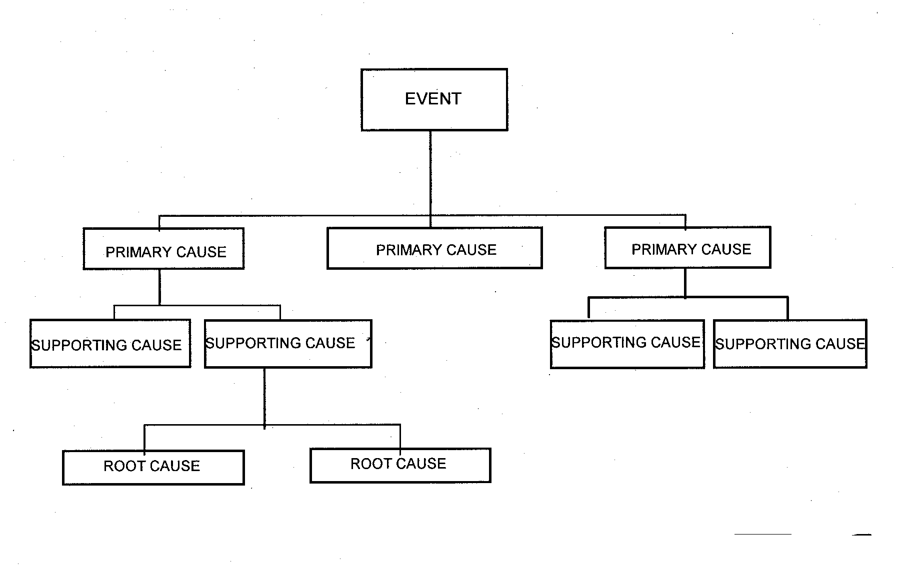
Step 1. Identify Hazards Logic Diagram
Generic Logic Diagram

Slide 19
Step 1. Identify Hazards Logic Diagram
s
Successful drive to SAREX
Man
Physically Ready
Mentally Ready
Example of Positive Logic Diagram
Emotionally Ready
Legally Ready
Machine
Mechanically Ready
Safety Equipment Ready
Media
Weather Conditions
Road Conditions
Road Structure
Management
Traffic Rules
Enforcement

Slide 20
Step 1. Identify Hazards Logic Diagram
Speeding
Example of Negative
Logic Diagram
Road Rage
Weather
Automobile
Accident
Inattention
Road Conditions
Reckless Driving
Mechanical Failure
Falling Asleep

Slide 21
Step 1. Identify Hazards Change Analysis
Used to analyze the hazard implications of planned or unplanned changes.
Focuses only on the changed aspect of event.
Compare the current situation with the previous one.
Only tool needed if operation has been subjected to in-depth hazard analysis.
Best accomplished using a simple worksheet.

Slide 22
Step 1. Identify Hazards Change Analysis Worksheet
Factors | Evaluated Situation | Comparable Situation | Difference | Significance
What Equipment Building Safety issues
Where In the process Location
When In time In sequence
Who Personnel Customer

Slide 23
Step 1. Identify Hazards Change Analysis Worksheet
Factors | Evaluated Situation | Comparable Situation | Difference | Significance
Task Procedure Goal
Working Conditions Duty day Weather
Trigger Event
Managerial Controls Chain of Command Hazard Analysis Risk Monitoring
To use the worksheet: Start at the top of the left column and work across. Consider the current situation. Compare it to a previous situation in a similar operation. Identify differences and determine if changes will cause any significant hazards. Modify worksheet to operation specifics.

Slide 24
Step 1. Identify Hazards Cause & Effect Tool
Brainstorming is used to identify causes, using the 5M Model, that may lead to a hazard.
Uses the “Fishbone” or Ishikawa Diagram, after inventor Professor Kaoru Ishikawa of Tokyo University, a highly regarded expert in quality management.
Illustrates hierarchical relationships between possible causes according to their level of importance.
Can be drawn on flip chart or whiteboard.
Variation of the Logic Diagram.

Slide 25
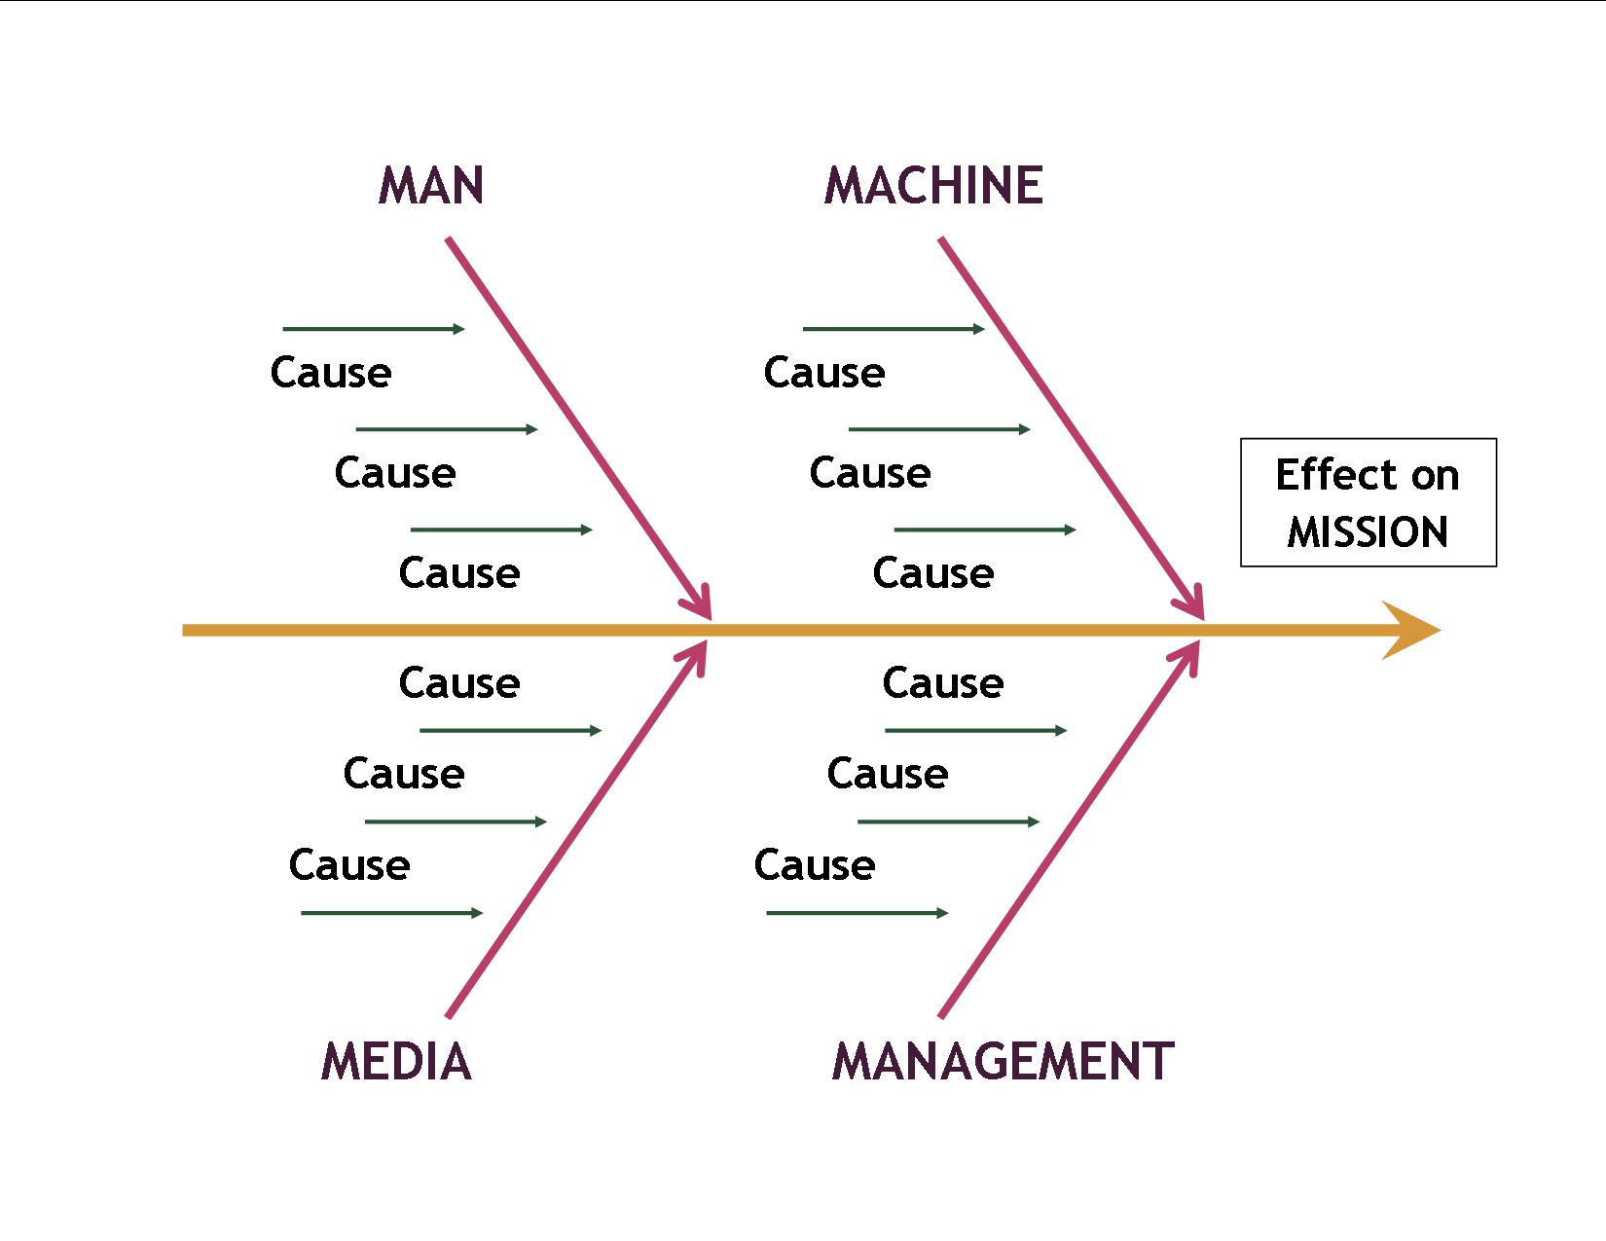
Step 1. Identify Hazards Cause & Effect Tool
“Fishbone” Diagram

Slide 26
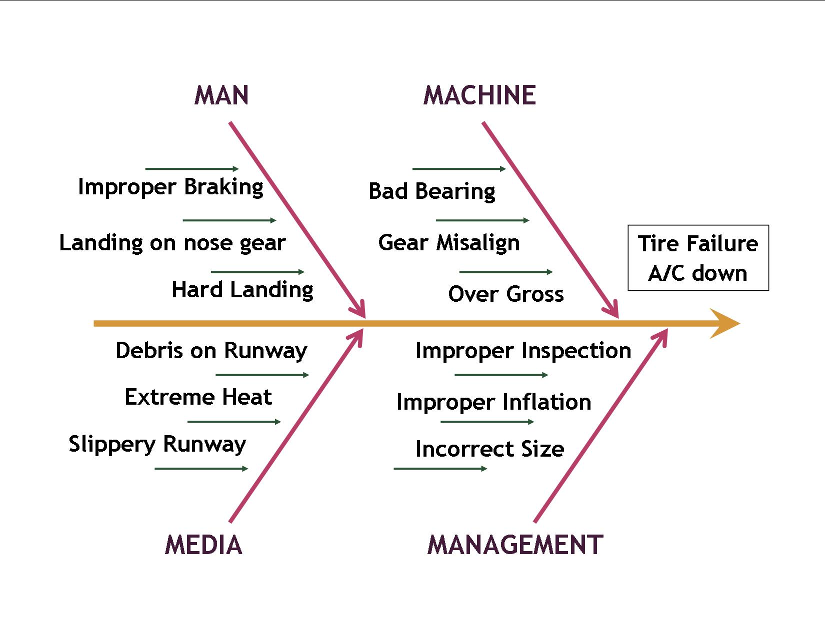
Step 1. Identify Hazards Cause & Effect Tool
“Fishbone” Diagram

Slide 27
Step 1. Identify Hazards Specialty Hazard ID Tool
USAF identifies 14 specialty hazard ID tools used to augment the primary tools.
Three are covered here:
The Mapping Tool
The Interface Analysis
Mission Protection Tool

Slide 28
Step 1. Identify Hazards Specialty Hazard ID Tool − A. The Mapping Tool
Involves using road maps, terrain maps, airport diagrams, facility blueprints and system schematics to identify sources of hazards.
Potential hazards are steep terrain, creeks and streams, winding mountainous roads, desert areas, flammables, and high voltage areas.
Locate energy sources and other hazards on the map and note distance to operation and resources.

Slide 29
Step 1. Identify Hazards Specialty Hazard ID Tool − A. The Mapping Tool
Someone who has seen the map object is an invaluable resource to consult. An on-site inspection should occur before the operation begins.
Incorporate these hazards into other Primary Hazard ID Tools

Slide 30
Step 1. Identify Hazards Specialty Hazard ID Tool − B. The Interface Analysis
Used to uncover potentially hazardous linkages or interfaces between unrelated activities.
A SAR/SAREX at a local airport may impose hazards to the local airport operations, facilities and pilots.
CAP operations at a airport not used before is a good cue to use the interface analysis and the Primary Hazard ID Change Analysis.

Slide 31
Step 1. Identify Hazards Specialty Hazard ID Tool − The Interface Analysis
Example Matrix
Energy Interface | Generators for Communication Trailers
Personnel Interface | Mission Base Personnel Flight line Personnel Airport Personnel
Equipment Interface | Aircraft Trailers | Antenna Vehicles
Supply Interface | Food Catering
Product Interface | Mission Base Equipment
Information Interface | ATC FBO
Bio-Material Interface | None

Slide 32
Step 1. Identify Hazards Specialty Hazard ID Tool − C. Mission Protection Tool
Designed to focus on protection of the mission rather than on protection of personnel or other assets.
Mitigates partially or completely stopping the mission by events that injure no one or cause no damage.
Identify key components of mission continuity and success and what could interrupt them.
Has no specific method or worksheet and is characterized by its focus.

Slide 33
Step 1. Identify Hazards Specialty Hazard ID Tool − C. Mission Protection Tool
Examples to consider that may prevent missions from proceeding are:
Computers or Internet service not available.
CAP Forms, weather reports, personnel contact information
Spare parts not available for resources.
Aircraft & vehicle tires, backup radios
Emergency at intended airport or FBO preventing setting up mission base.

Slide 34
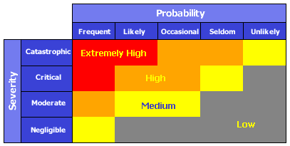
Step 2. Assess the Risk
Risk is assessed based on exposure, severity, and probability in the order of most likely to least likely to happen using the risk assessment matrix.

Slide 35
Step 2. Assess the Risk
Three Problems with Standard Matrix
Subjectivity in the two dimensions of the matrix due to individual interpretation of Severity and Probability.
Inconsistency because of subjectivity. Problem arises if the two hazards are competing for same risk control resource.
Only four ranges with most falling in the medium and high risk level.

Slide 36
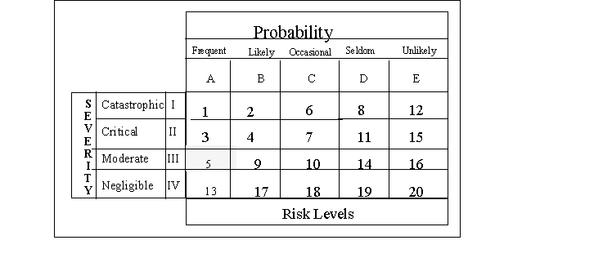
Step 2. Assess the Risk
Modified Risk Matrix

Slide 37
Step 2. Assess the Risk
Modified Risk Matrix
20 levels of risk, using a top-down order of priority. Highest risk is number 1.
Helps to prioritize risk control efforts.
Can be used to group risks into clusters of related risks.
Does not replace the standard matrix but augments it.

Slide 38
Step 3. Analyze Risk Control Measures
Analyzing Risk Control Measures involves three actions.
Identify Control Options
Determine Control Effects
Prioritize Control Measures
Important to keep risk at the best acceptable level using control options, even if risk seems to be at an acceptable level.

Slide 39
Step 3. Analyze Risk Control Measures Identify Control Options
Eight major risk control options are designed to have the broadest application:
Reject the Risk
Avoid the Risk
Delay the Risk
Transfer the Risk
Spread the Risk
Compensate for the Risk
Accept the Risk
Reduce the Risk

Slide 40
Step 3. Analyze Risk Control Measures Identify Control Options
Reject the Risk if overall risks exceed benefits. It is the correct option if you do not have the authority to put proper controls in place.
Avoid the Risk by going around it or by performing the operation in another way.
Delay the Risk is the right answer if there is no urgency to perform the operation. The hazard could go away or the operation may not needed.

Slide 41
Step 3. Analyze Risk Control Measures Identify Control Options
Transfer the Risk to another individual or operation. The hazard is not eliminated but may be better controlled with a different operator and/or equipment.
Spread the Risk by increasing the exposure distance or increase the time between exposure events.
Compensate for the Risk by having redundant capabilities; extra resources or parts.
Accept the Risk if benefits exceed the cost in personnel and resources. Use risk controls to reduce the risk to it’s lowest possible level.

Slide 42
Step 3. Analyze Risk Control Measures Identify Control Options
Reduce the Risk is the most widely used option. Brainstorm to come up with ideas or use the Risk Control Options Matrix.
Risk Control Options Matrix uses 46 proven ways to reduce risk from most preferred to least preferred control area

Slide 43
Step 3. Analyze Risk Control Measures Risk Control Options Matrix
Options | Examples
ENGINEER/ENERGY MANAGEMENT Limit Energy Substitute Safer Form Prevent Buildup Prevent Release Provide Slow Release Re-channel/Separate in Time/Space Provide Special Maintenance of Controls | Reduce speeds, reduce heights Less hazardous chemicals Automatic cutoffs, limit momentum Containment, chock A/C & vehicles Use energy absorbing materials Barriers, launch A/C farther apart Special procedures, checklists
GUARD On Source Barrier Between On Human or Object Raise Threshold (Harden) | Fire suppression, energy absorption Walls, distance Personal protective equipment Reinforce, physical conditioning

Slide 44
Step 3. Analyze Risk Control Measures Risk Control Options Matrix (Cont’d)
IMPROVE TASK DESIGN Sequence of Events/Flow Timing (within/between tasks) Man-Machine Interface/ Ergonomics Simplify Tasks Reduce Tasks Loads Physical, Mental, Emotional Backout Options | Toughest task first, only a few in a row Allow enough time, don’t rush Proper fitting equipment, good design Provide job aids, safely reduce steps Set weight limits, use automation Avoid excessive stress, provide breaks Stop process if new hazards observed
LIMIT EXPOSURE Number of People/Items Time Interactions | Only expose essential personnel & things Minimize time of exposure Limit repeat exposures
SELECTION OF PERSONNEL Mental Criteria Emotional Criteria Physical Criteria Experience | Essential skills,proficiency,common sense Essential stability and maturity Essential strength,endurance,motor skills Demonstrate performance abilities

Slide 45
Step 3. Analyze Risk Control Measures Risk Control Options Matrix (Cont’d)
TRAIN AND EDUCATE Core Tasks (especially critical tasks) Leader Tasks Emergency Contingency Tasks Safety Tasks Rehearsals | Define min abilities: train, test, score Define leader standards: train,test,score Define, assign, train, verify ability Hazard ID, risk controls, standards Validate process, skills, verify interfaces
WARN Signs/Color Coding Audio/Visual Alarms Briefings | Warning, instruction and traffic signs Bells, flares, flashing lights, whistles Refresher training, demonstrate hazards
MOTIVATE Measurable Standards Essential Accountability Positive/Negative Incentives Competition Demonstrations of Effects | Define min acceptable risk controls Check performance at essential levels Meaningful awards or punishment Healthy competition on a fair basis Graphic, dynamic, tasteful demos of effects of unsafe acts

Slide 46
Step 3. Analyze Risk Control Measures Risk Control Options Matrix (Cont’d)
REDUCE EFFECTS EMERGENCY Equipment Rescue Capabilities Emergency Medical Care Emergency Damage Control Procedures Backup/Redundant Capabilities | Fire Extinguishers, first aid materials Rescue squad, equipment, 911 Quality first aid personnel and facilities Emergency responses, co-agencies Alternate ways to perform mission
REHABILITATE Personnel Facilities/Equipment Mission Capabilities | Rehabilitate to restore confidence Return key elements back to service Focus on restoration of mission

Slide 47
Step 3. Analyze Risk Control Measures
Determine Control Effects. From the control matrix, determine what effect each option will have on the associated hazard.
Prioritize Risk Controls. Controls must be chosen and prioritized that make the most effective and efficient use of mission available resources. Establish guidelines that will direct which control measure to recommend and implement.

Slide 48
Step 3. Analyze Risk Control Measures
Guidelines for selecting risk control measures
Follow all published directives.
Select combinations yielding the most mission-supportive risk level; not necessary the lowest risk as there is a risk of mission ineffectiveness with not taking risks.
Avoid incompatible risk controls. Do not have only Gatorade available to combat dehydration if persons are allergic to food additives; have water available also.
Choose risk controls that reinforce each other. Discipline safety rule violators and have a special awards program for following safety procedures and being accident free.

Slide 49
Step 3. Analyze Risk Control Measures
Guidelines for selecting risk control measures
Evaluate full costs versus full benefits, not isolated areas. Apply controls to activities and personnel actually at risk.
Choose redundant risk controls when it is mission supportive, practical and cost effective, but do not waste resources. The goal is optimum risk control.

Slide 50
Step 4. Make Control Decisions
Develop a decision making process and system that establishes who will select the risk controls to implement and who determines the final go/no-go decision.
EXAMPLE of Risk Decision Making Personnel for SAREX
Risk Level | Decision Level
01-03, Extremely High 04-08, High 09-13, Medium 14-20, Low | Wing Commander Incident Commander Mission Safety Officer Operations/Planning Section Chief

Slide 51
Step 4. Make Control Decisions
The decision maker
Must pick the controls.
Oversee their implementation.
Decide how much to spend.
Be responsible for the outcome of the operation.
Be able to obtain resources needed.
Be in control of the resources.
Have authority in the chain of command.
Implement a good decision making process by using a decision matrix.

Slide 52
Step 4. Make Control Decisions
Rank each risk control option considering on a scale of 1 to 10, 1 being the lowest and 10 the highest, on a list of chosen desirable characteristics. Add up each risk’s score. The option with the highest score is chosen.
An example of decision matrix follows:

Slide 53
Step 4. Make Control Decisions
Example of Decision Matrix
Characteristics | Control Option: 1 | 2 | 3 | 4 | 5 | 6 | 7
Low Cost | 5 | 8 | 6 | 10 | 4 | 9 | 9
Easy to Implement | 8 | 8 | 5 | 9 | 9 | 5 | 7
Positive Operator Involvement | 7 | 4 | 7 | 10 | 6 | 4 | 8
Consistent with Culture | 5 | 7 | 6 | 7 | 6 | 3 | 6
Easy to Integrate | 1 | 6 | 2 | 10 | 5 | 9 | 7
Easy to Measure | 8 | 4 | 9 | 5 | 8 | 7 | 9
Low Risk/Sure to Succeed | 8 | 10 | 7 | 9 | 10 | 8 | 9
TOTALS | 42 | 47 | 42 | 60 | 48 | 45 | 55

Slide 54
Step 5. Implement Risk Controls
Once the risk control decision is made, assets must be made available to implement specific controls.
To implement risk controls
Develop a complete action plan
Establish accountability
Provide a means of resource support

Slide 55
Step 5. Implement Risk Controls
Develop an action plan to manage the control options:
Determine all manpower and resources needed.
Estimate cost to implement each control.
Set a timeline that clearly sets milestones and goals.
Assign tasks and due-dates to specific personnel.
Enlist user input to establishment ownership.
Provide job aids, tools and examples to make implementation clear to everyone.
Measure performance.
Document any outside support given.

Slide 56
Step 5. Implement Risk Controls
Establish levels of accountability:
Identify person responsible for successful implementation of each control measure.
Identify unit or operations level person responsible for the implementation as a whole.
Combine the power of command with leadership to maintain accountability.
Establish motivation and create meaningful and positive incentives for success.
Involve persons affected by the controls during implementation.

Slide 57
Step 5. Implement Risk Controls
Resource support includes six components:
Policy support with operating instructions, technical orders, and any standard operating procedures.
Command support showing the absolute backing of the leadership.
Training support for personnel implementing controls.
Tools support including job aids, checklists, decision guides and instructions.
Measurement support to determine if timelines, schedules and standards are being met.
Motivation support providing the positive and negative incentives for a successful risk control.

Slide 58
Step 6. Supervise and Review
Determining the effectiveness of risk control involves setting a goal, knowing where you are in relation to the goal, and a plan in place to reach the goal.
This last step of ORM involves
Supervise
Review
Feedback

Slide 59
Step 6. Supervise and Review
Supervise the implementation plan, insure all are in place, monitor all controls, and make certain they are effective.
Controls are effective if they bring about favorable changes to the physical condition or personal behavior.
If control is ineffective, correct or discontinue.
Can use the Change Analysis Tool from Step 1 to reevaluate any changes that require further risk management.

Slide 60
Step 6. Supervise and Review
Review the total cost verses total benefits the controls provide; for each control consider both physical and behavioral changes.
Costs should be in line with expectations. The benefits in risk reduction should be greater than the cost of the control measure.
Benefits or effectiveness of controls should be compared to forecasted goals.
A simple cost vs. benefit matrix is recommended.

Slide 61
Step 6. Supervise and Review
Feedback is the essential element in Step 6. It provides the ability to share success and failure. One of the basic rules of ORM is to stop reinventing the wheel and learn from past practices and from the mistakes of others.
Feedback should go to all personnel; from new cadets to commanders. Effective risk controls that increase the overall mission success should be a part of every CAP member’s lessons learned file.

Slide 62
Conclusion
To fully realize all the benefits from ORM, it must be integrated into every aspect of CAP’s organization and it’s missions.
All levels of CAP should proactively promote and use ORM.
It’s use will benefit everyone by improving mission capability, enhancing better decision making, reducing accidents and injuries, preserving our assets.

Slide 63
References
Air Force Policy Directive 90-9, Operational Risk Management
Air Force Instruction 90-901, Operational Risk Management
Air Force Pamphlet 90-902, Operational Risk Management (ORM) Guidelines and Tools

Slide 64
Civil Air Patrol wishes to thank the USAF Safety Center for the use of their information in the creation of this presentation.

Slide 65
Close the presentation. Verify that you have read the required material then click the “Start Quiz” button.
Thank your for your support of CAP’s safety program.
65
Notes:
65

