Slide 1
Level 5
06 Mentoring Programs
Capt Karen Padgett, CAP
Karen.Padgett@akwg.cap.gov
19 May 2024

Slide 2
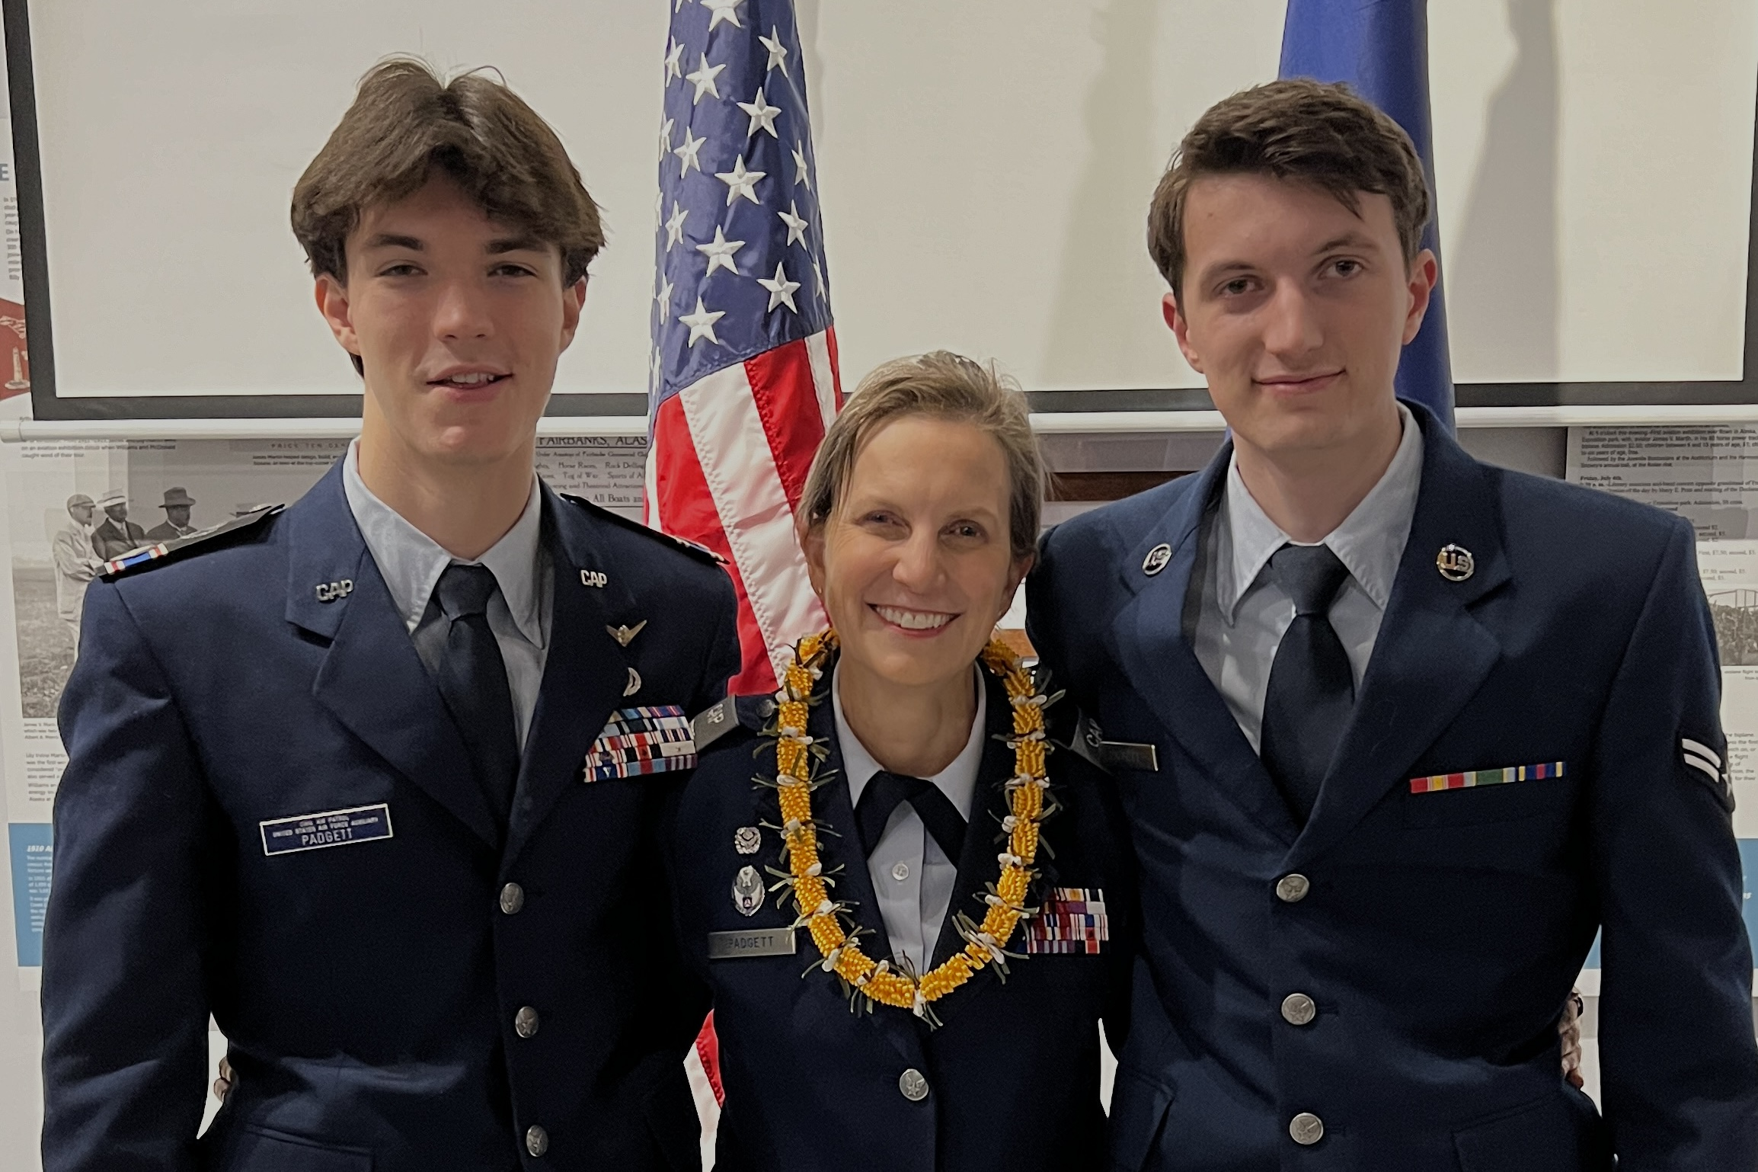
Capt Karen Padgett, CAP
1999 Joined CAP to hang out in airplanes with Maj Padgett
2018 Rejoined CAP when our youngest turned 12—Stood up Lake Hood Cadet Squadron in Anchorage, AK (World’s Largest Sea Plan Base!)
2020-2023—Squadron CC
2021-present—AKWG DCP & Wing CDI
2022 Completed Level 5
Specialty Track Junkie--Master in Command, Cadet Programs, Character Development & Personnel. Senior in E&T & Aerospace.

Slide 3
“Tell me and I forget, teach me and I may remember, involve me and I learn.”
Benjamin Franklin

Slide 4
DLOs
Reflect on the value of sharing knowledge, the benefits of mentoring, and the importance of building the bench
Review fundamental aspects of mentoring to include the mentoring relationship
Employ the fundamentals of performance monitoring and improvement
FOCUS AREA: Ensure the effective use of mentoring improves the organization
ROE: Mentoring is a hot button topic! We will focus on the positive, and find solutions for improving mentoring in our Civil Air Patrol
NOTE: This PowerPoint available until ~22 June 24 at https://akwg.cap.gov/programs/cp/cpos

Slide 5
DLOs
DLO #1: Reflect on the value of sharing knowledge, the benefits of mentoring, and the importance of building the bench
Excerpts
Building the Bench—why is this important?
Not get burned out & grumpy
Many hands make light work
Advance our E&T
Strategic leaders focus on strategic tasks
Someone take our place so we can advance, and so we can try other jobs
Example to cadets
Recruiting & Retention
Generativity

Slide 6
DLOs
DLO #2: Review fundamental aspects of mentoring to include the mentoring relationship
Formal mentoring programs: https://www.gocivilairpatrol.com/members/ed-training/mentoring
VolU Instructors—Levels 1, 2, 3, 4 & 5 (https://www.gocivilairpatrol.com/members/ed-training/volu-main)
TLC Instructors (Your Wing DCP or https://www.gocivilairpatrol.com/programs/cadets/cpofficer/tlc/nationally-offered-courses)

Slide 7
DLOs
DLO #2 (continued): Review fundamental aspects of mentoring to include the mentoring relationship
Conference Presentations
Instructing at other OPR Training Sessions (AE conferences, Chaplain Corps Region Staff Colleges, etc.)
Specialty Track mentoring—Periodically request Specialty Track Member Report (SQTRs are coming!)
Informal/ad hoc mentoring
Please recommend/approve specialty tracks, classes, and promotions ASAP

Slide 8
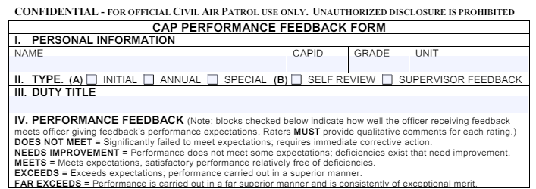
DLOs
DLO #3: Employ the fundamentals of performance monitoring and improvement
CAPF 40:
Required for Command Specialty Track
Where else is a CAPF 40 required?
Do you ever use this form?

Slide 9
DLOs
DLO #4: Ensure the effective use of mentoring improves the organization

Slide 10
Discussion
Lead off question: Why do we need mentoring programs?
Supporting Question: What are the benefits of mentoring programs?
Supporting Question: What are the difficulties in building mentoring programs?
Supporting Question: How can we overcome the challenges associated with mentoring programs?
Supporting Question: Why is continuous improvement important for mentoring programs?

Slide 11
Hope on the Horizon
SQTR-style Specialty Track STAK tracking
Absorb (~Summer 2024)
Easier to direct mentees to helpful modules
Print your Member Search Report early & often
TLC On-Demand course (~Fall 2024)
Unified websites→what’s an alternative? Each wing’s IT platform
Anyone know of any other new developments?

Slide 12
Discussion/Activity
Brainstorm areas that would benefit from mentoring
Specialty tracks (e.g., Command, Cadet Programs
Activities (e.g., RCLS, Flight Academies)
Among members at same level (e.g., Members of a group who have achieved Level 4 periodically get together in person or virtually)
SM *Selection* of a specialty track & how to get started in it
Note: Some specialty tracks very difficult. AE is relatively quick, fun, and one of CAP’s 3 missions!
Higher-Headquarters Critical/Mission Staff Offices
.
.
.
Cadet Programs: >1/2 the position papers related to Cadet Programs, and 4 of PCRs 6 DCPs are in this class…Maj Hughes pick a date/time for the 4 DCPs & other interested parties from this class to meet in this Teams Room
.

Slide 13
Discussion/Activity
Brainstorm Methods/tools to help mentor
Website/shared documents (PCR website…?)
Mentoring as its own specialty track!
Your Level 5 Capstone projects
Pamphlet for a specialty track or other specific activity/topic
Other mentoring-related Capstone ideas…
.
.
.
Suggest it to your Cadet Advisory Council (think tank)
Monthly (periodic) interactive webinar
Peer chat group (text/What’sApp/GoogleSpace/etc)
Periodic feedback (formal CAPF 40 or informal)
Specialty Track reports—who can mentor each track
Regular in-person checkins
Notebooks/organizers/continuity files/color coding
Certificates of appreciation

Slide 14
Discussion/Activity
Brainstorm Methods/tools to help mentor (continued).
How to counter PCR-Specific challenges: Tyranny of distance, multiple time zones, wide climate/geography variation, etc
.
.
Who is apt to be overlooked & how can we help them?
.
.
.
Discuss further during our Level 5 “Challenges” module?
Members of *this* Level 5 class continue the discussion?
This PowerPoint available until ~22 June 24 at https://akwg.cap.gov/programs/cp/cpos

Slide 15
Conclusion
YOU, Level 5 students, are the ideal mentors ☺
Your Level 5 instructors appreciate your patience as we learn how to best offer a Level 5 opportunity for all of you. We appreciate your dedication to CAP and to the people you lead, follow, and serve alongside. Taking this class is a huge investment of your time and effort, and we hope this class helps update you on all available resources, that you continue to share your vast wisdom and knowledge, and that you make some new friends.

