Slide 1

2023 Alaska wing
Cadet Competition
(WCC) Introduction
CAPP 60-75 (National Cadet Competition Program Guide )
CAPP 60-33 (Drill & Ceremonies)
CAPP 60-50 (Fitness Guide)
CAPR 39-1 (Uniform Manual)
CAPR 39-3 (Awards Manual)
Maj Edward Stickel
cao 06 OCT 2022

Slide 2
Objectives:
Mission of Cadet Competition
Team Eligibility
Hybrid Competition Plan
Overview of the NCC program and events
How to Win!
Competition Schedule

Slide 3
“NCC PROGRAM”
MISSION: The CAP National Cadet Competition program showcases the full range of challenges in cadet life experienced at the squadron level, and new areas of learning that are important to America.
VISION: Squadrons and individual cadets motivated to excel in all facets of the CAP Cadet Program

Slide 4
Wing Competition Eligibility
Primary Teams should be a “6-cadet team” but can have the minimum of 4 cadets (with two “ghost” members)
Each Squadron can run max of two teams including combo teams
Team rosters can be changed after registration up to the start of the competition.
“Top two teams from Wing may be eligible to compete at the Region Competition”
Note: any two teams competing at the regional level may not be from the same squadron

Slide 5
Combination & 2nd Teams
Combination teams can be from no more than two squadrons
Combination teams and second teams must be 6 person teams
“no ghosts on roster” (emergency ghost for Combo/2nd teams cadets will be judged on a case-by-case basis)
Combo teams must do drill events in-person with each other & everyone must participate in at least one 4-person drill event
(“Standard Colors Drill” or “Indoor Posting”)

Slide 6
Event Overview
Core Team Events
  Indoor Practical
  Standard Colors Drill
  Standard Element Drill
  Team Leadership Problem
  Inspection (Spot)
  Uniform Build (Prep) x2
  Physical Fitness Exam (PFT)
  Written Exam
  Outdoor Practical (Flag Raising) (NOT an event for 2023)
Electives Team Events
- Service Project (Pre-Competition)
- Knowledge Quiz “Kahoot”

Slide 7
Hybrid Competition Plan
Team Leaders’ Meeting 10am SAT 18NOV23 virtual (Google Meet code aak-zpnn-ajn)
Two-Day event on Saturdays 25th NOV & 2nd DEC
  Day 1: 0900-1600 on Sat 25NOV23 100% Virtual (Uniform: Physical Fitness Gear)
    Events: - Written - Physical Fitness Test
    - Service Project - Team Leadership Problem
    - Knowledge Quiz (Round 1) - Uniform Prep (Build) x2
  Day 2: 0900-1600 Sat 02DEC23 In- person (or Virtual if preferred) (Uniform: Class “B” Blues, no tie)
    Events: - Indoor Posting - Standard Colors Drill (modified)
            - Knowledge Quiz (Round 2) - Element Drill
--There is no scoring advantage to being In-person vs Virtual--

Slide 8
Wing “Ghost” Cadet Rules
Primary Teams may have up to two “ghost” members
Combo teams & Secondary teams may only have ghost cadets in emergency situations and must have full 6-person rosters at registration.
    Events scores Affected by ghost cadets:
    - Written - Physical Fitness Test
    CAPP 60-75 page: 14 CAPP 60-75 page: 16
    Events Not Affected: - Indoor Posting - Standard Colors Drill
            - Uniform Prep (Build) - Element Drill*
    - Service Project - Team Leadership Problem*
    - Knowledge Quiz

Slide 9
Sign-up & Cost
To sign your Team up for the WCC:
please use this Google Form registration link on the next slide. It is also posted on WCC website.
Teams must designate what cadets are participating in: Indoor colors,
  standard colors, and the service project. (Team’s may reassign team members up until the day before Comp)
  Wing Email address required for each cadet!!!
  https://docs.google.com/a/akwg.cap.gov/forms/d/e/1FAIpQLScDak8Ofm4ZX_3dFokXjvuHFByuNs7L3yCWfzi0YfEtzQs10w/viewform
Cost (teams pay for their own members' meals at Dining Facility and/or Subway or equivalent)
  All Virtual Teams $0.00 “Free”
  One Day WCC $20.00
  Lunch only (or per meal) $10.00

Slide 10
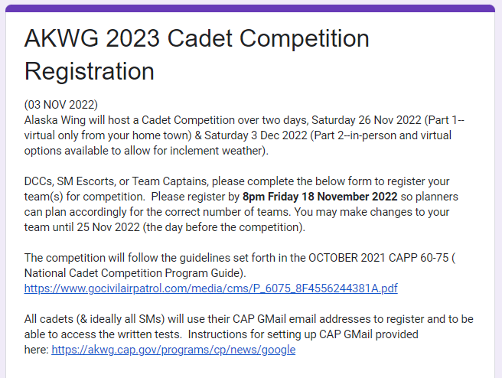
Sign-up here: on Google Forms
https://docs.google.com/forms/d/e/1FAIpQLSfUuBTL0tmQjwGdOrkO1mKEGCSmZ9f8FKK-0ndee6FhpJx3Vg/viewform

Slide 11
Required Equipment
  Physical Fitness Test
  Basketball court or equal area
  100’ or 30m Measuring Tape*
  Sit & Reach Box
  Fitness mat (for sit-ups)
  12 cones
  Indoor
  - Doorway 80’’ height
  - Table 4’x4’
  Extension cord
  - 6 Chairs
  Service Project
  1- microphone
  1- Laptop
  1- Power Point Slideshow
  1 set- Computer Speakers
  TLP
  10m x 10m open area
  Written
  2 - 6’ tables with chairs
  6 – laptops/tablets
  Element Drill
  10m x 10m area
  30m Measuring Tape*
  Standard Dill
  18’x15’ area
  30m Measuring Tape*
  Kahoot!
  1- Laptop/Smartphone
  Ceremonial Equipment
  2- Flags (American Required) on 8’ poles
  2- Flag stands (bases/stanchions)
  2- Flag carriers (flag harnesses)
  2- Rifle Barriers belts (optional)
  2- Drill Rifles (brown or white)
  4- Sets white gloves (optional)
  Uniform Build
  1-Male & Female blues shirt
  1-Ribbon and Badges Kit
  1-Set of rank insignias
  2-Rulers (large & small)

Slide 12
Indoor Posting Of The Colors
Objectives: (1) Encourage squadrons to form a color guard capable of showing proper honor to the colors during local civic events.
(2) Recognize excellence in the technical drill & ceremonies in a realistic scenario where a color guard is asked to post and retrieve colors at an indoor event.

Slide 13
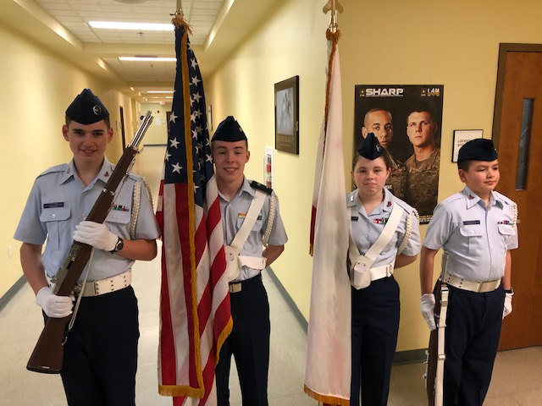
IN-DOOR PRATICAL
Objective: To post & retrieve Colors indoors
Conditions: 4-Cadet Team
Planning (not scored)
- Teams will have 7 minutes to plan & move/set up the room.
Posting
  Marshal commands, “Post the Colors”
  Most expeditious manner
Retrieval
- Marshal commands, “Retrieve the Colors”
- Most expeditious manner
See CAPP 60-75 page 10

Slide 14
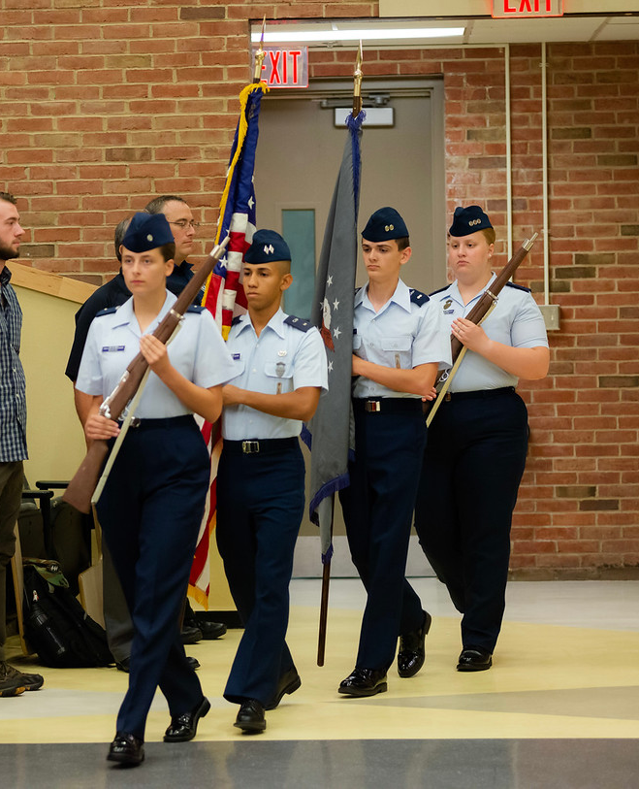
Set-up & Rules
Basic Scenario:
- Low ceiling scenario
- Two flags to be posted
- Teams will start and finish through a doorway
- Teams must avoid obstacles
(no penalty for stepping on extension cord safely)
7-minute planning phase
Only flag bases/stands can be moved
Common Errors:
No about faces or To-the-rear permitted with the flags
No left face permitted if it inverts the flags
Team must present colors to the audience
- Flag handlers must salute the flag
No spinning of the rifles
See CAPP 60-33 ch7
Equipment Required:
- Rifles & Flags (no gloves, guard belts or flag harnesses required)
(CAPP 60-33 p102)
(CAPP 60-33 p109)

Slide 15

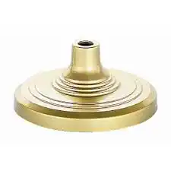
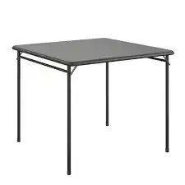
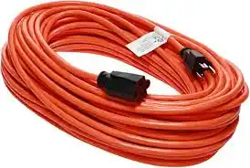
Entry
&
Exit
Doorway
Updated OCT 2023
80’’
Screen
Projector Table
Table with laptop or camera
9’
3’sq
Reporting
Area
6’
20’
Extension cord
5’
6’
7’
15’
18’

Slide 16
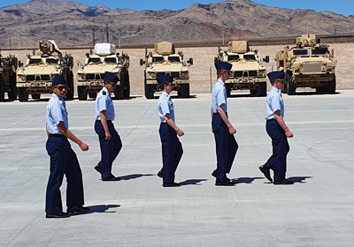
Standard Element Drill
Objective: This portion
of the competition tests each team’s proficiency in marching as a single standard element.

Slide 17
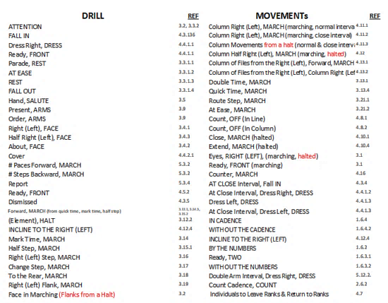
Drill Card
Options
23-32
Drill Movements Per-Card
“Start and end at the same spot. Per the card design”
Taken from CAPP 60-33 p113)

Slide 18
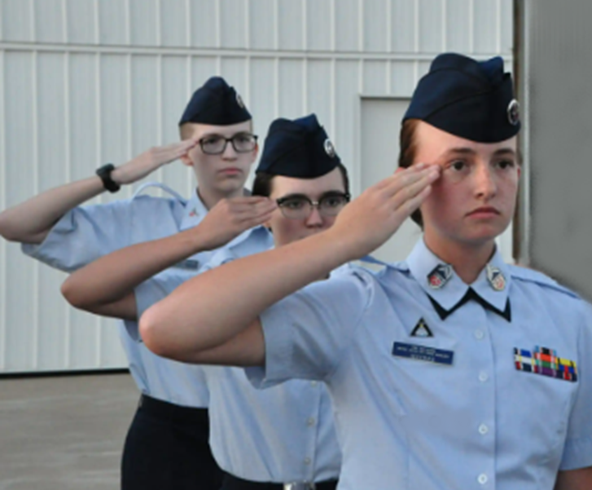
Set-up & Rules
Basic Scenario:
- 10m x 10m drill pad with boundary markers
- Smart phone or Computer with printer for Drill Card
(for virtual teams only)
Common Errors:
Not performing movements as described in
CAPP 60-33
Equipment Required:
- Covers (Gloves not required)

Slide 19
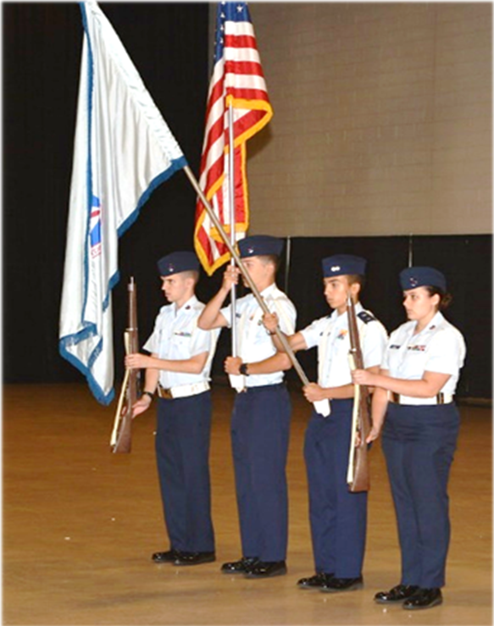
STANDARD Colors DRILL
Objective:
This portion of the competition tests each team’s proficiency in marching as a color guard team in a parade scenario.

Slide 20
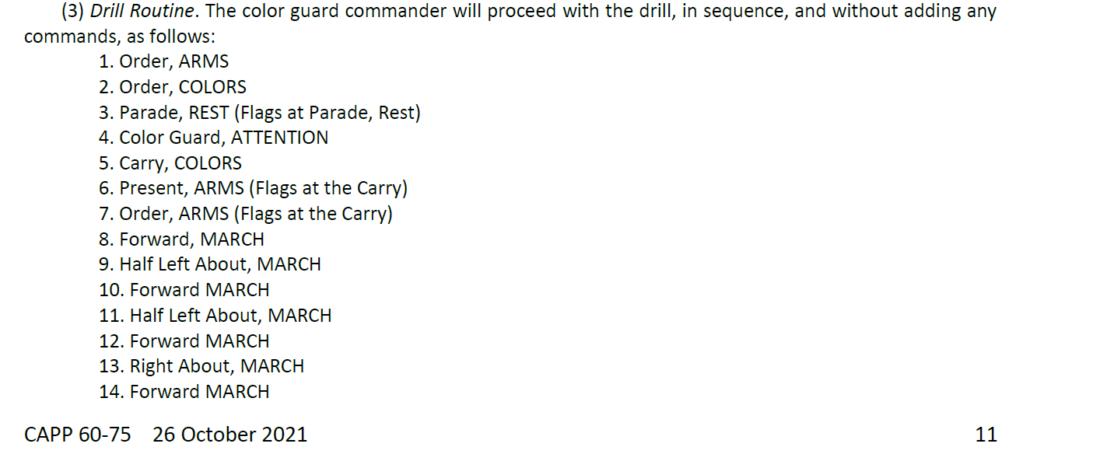
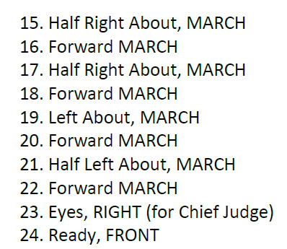
“Modified”
Color Guard Standard Drill
& Rifles at shoulder

Slide 21

“Modified”
Color Guard Standard Drill
13
March IN
Report -in
Commands
1-8
14
STOP
10 meters By
10 meters
Square
16
Movements
17-20
8
12
11
9
9
10
16
15
19
March OUT
21
22
23 &
24

Slide 22
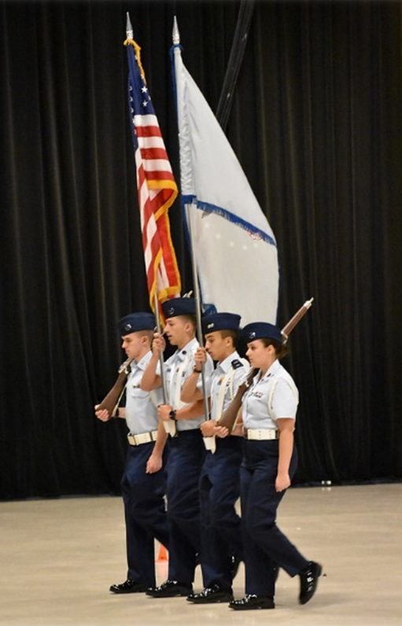
Set-up & Rules
Basic Scenario:
- 10mx10m drill pad with boundary markers
- Modified drill sequenced
Common Errors:
Not performing movements as described in
CAPP 60-33 Ch-7
Not memorizing drill sequence
Not Projecting Commands
Performing Wheels instead of Abouts
Equipment Required:
- Rifles, Flags, Flag harnesses,
(glovers, Guard Belts Optional)

Slide 23
Team Leadership Problem
(TLP)
Objective: Test a team’s ability to collectively analyze a problem, creatively imagine a solution, and collaborate as a team on a specially- designed puzzle or game

Slide 24
Team Leadership Problem

Slide 25
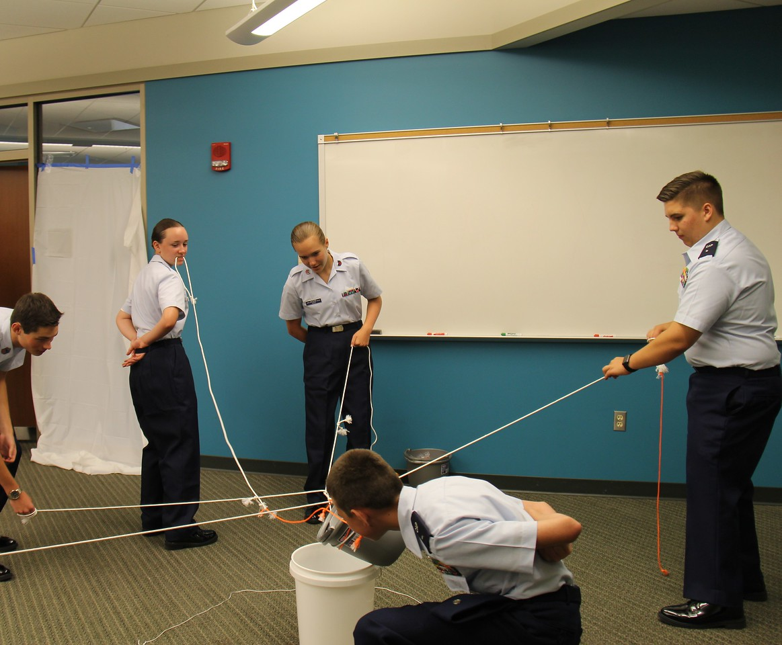
Sample Limitations
  Removal of communication
  Removal the 5 senses (sight, touch, hearing, smell & taste)
  Restriction of mobility
Time
Tools & Supplies
  Useful supplies
  Distracters
  Skills and abilities of team members
Goal or Mission
  Problem solving
  Thinking outside of the box
  Asking judges pointed questions
  Scoring matrix

Slide 26
Set-up & Rules
Basic Scenario:
- 20’x20’ drill pad
Common Errors:
Not speaking loud enough for judges to hear
Members not participation or talking
One person dominating the whole team
Equipment Required:
TBD

Slide 27
Uniform Build (Prep)
Objective: Cadets display their knowledge of the uniform by building TWO Uniforms from two stories they are given. Each team is scored in total points compared among other teams.

Slide 28
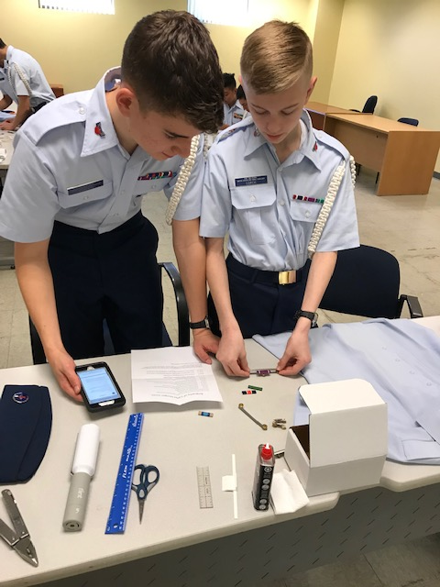
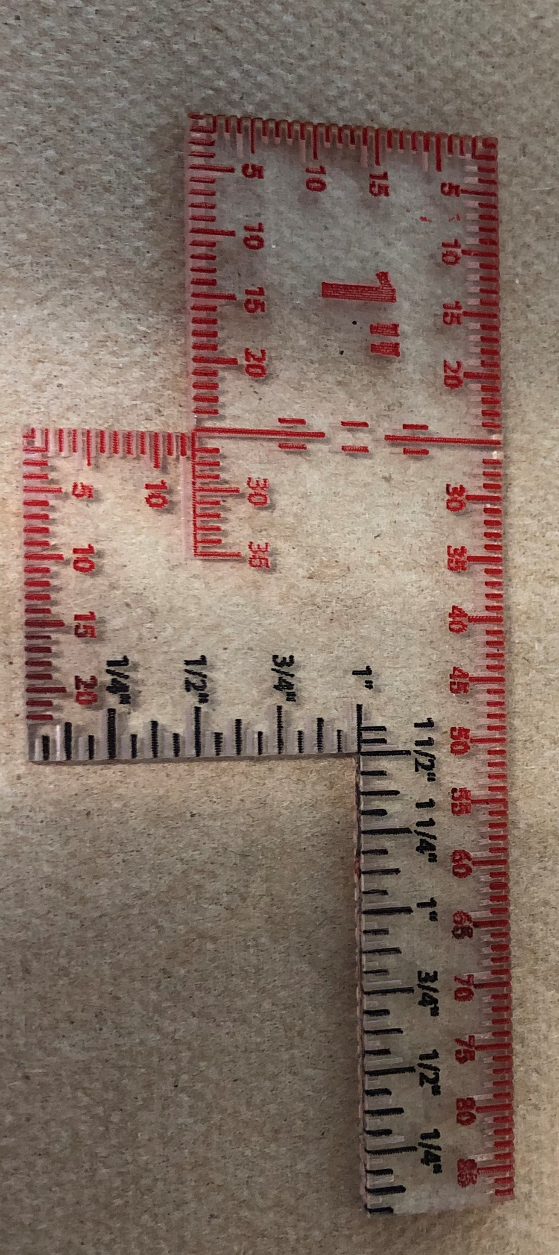
Uniform “Preparation” build
The EM will select at random four cadets per team to participate in the two uniform preparation portions. of the inspection event. These four cadets work together in groups of two on a single dossier listing a hypothetical. cadet’s grade and accomplishments. Fully rigging that uniform within 20 minutes. One group of the two will work on a cadet officer’s dossier while the other will work on a cadet enlisted dossier. Both male and female uniforms will be used one per dossier. This is to include both service dress shirts and covers for each gender. Their task is to select the necessary insignia from the assortment provided to them and place it correctly on the uniform. Additionally, teams will be required to bring both a male and female service dress blues shirt fully ironed and prepped on a hanger for this event. The hypothetical cadet’s uniform will not be worn but displayed on clothes hangers for inspection. Cadets will have access to CAPR 39-1, a ruler, pinning foam block and all necessary accouterments for the build. EM may utilize neutral uniform items for judging placement for the purpose of cost saving. Providing the correct uniform build accouterments can be otherwise represented. Whether buy simulation of the uniform accouterments or by the use of selection forms. The use of “Color Form” Ribbons is required for this event in order to cost effetely represent all possible ribbon options for each build.
WCC Rules: Judges will inspect using the special ruler supplied to all teams.

Slide 29
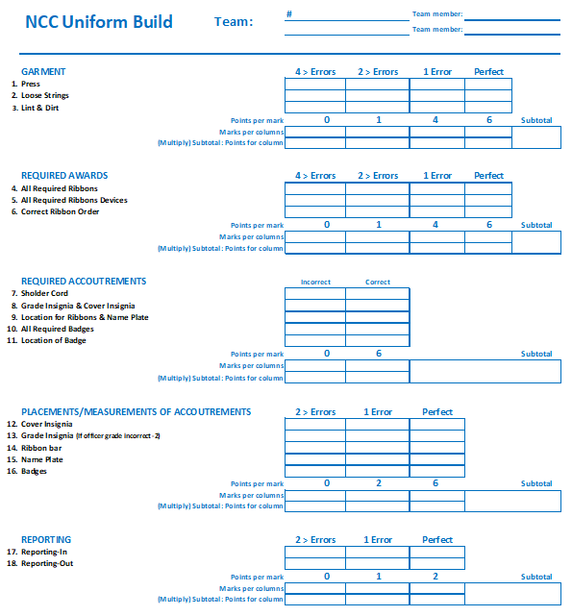
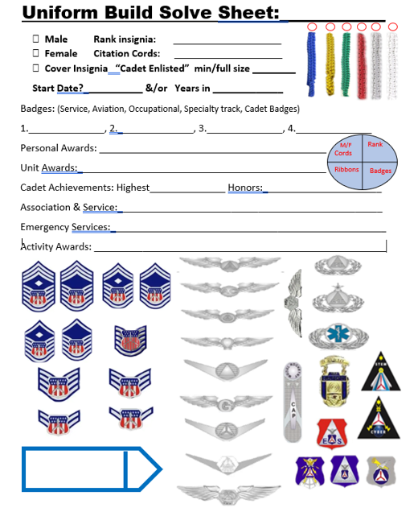
Uniform Perp & selection Sheets
Available on the Alaska Wing WCC page:
https://akwg.cap.gov/programs/cp/activities/23cc

Slide 30
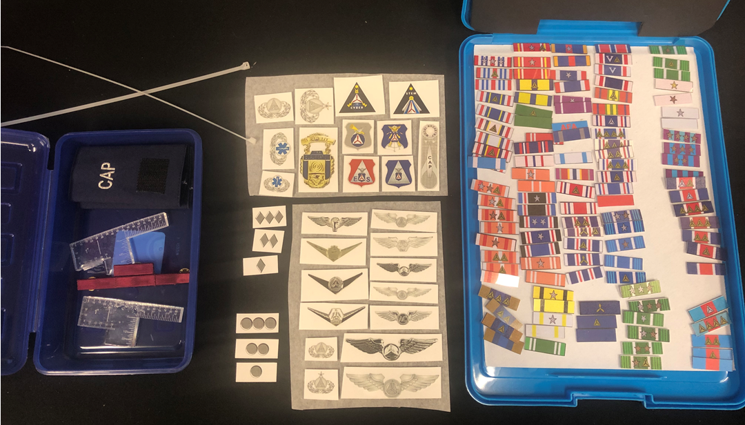
WCC Uniform Build Kit
Sent to Unit ahead of time:
- 4Ribbon bar with blank ribbons
(to go on shirt)
- Ribbon kit (collection of ribbons)
- Officer rank set
- Custom uniform rulers

Slide 31
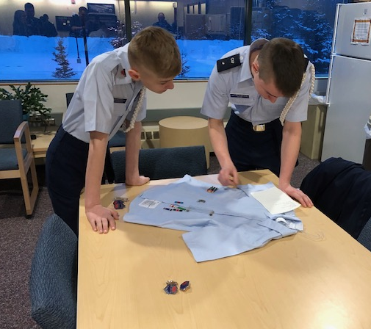
Set-up By the Team
Provided By You, the Team:
1-Pre-Ironed & prepped Male blues shirt (long or short sleeve is acceptable)
1-Pre-Ironed & prepped Female blues shirt (long or short sleeve is acceptable)
1-Ironing board or Pinning board
1- Large ruler (18’’ or longer)
1- Cadet name plate
1- Set of Rank insignia C/Amn-C/CMSgt
1- Technician Badge of Any kind
1- Pilot wings of any kind
1- Ground team/EMT badge of any kind

Slide 32
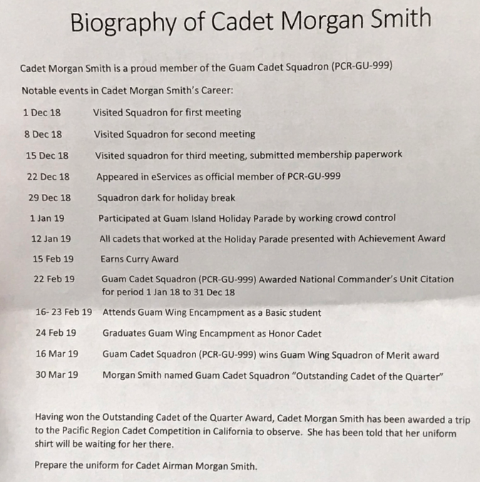
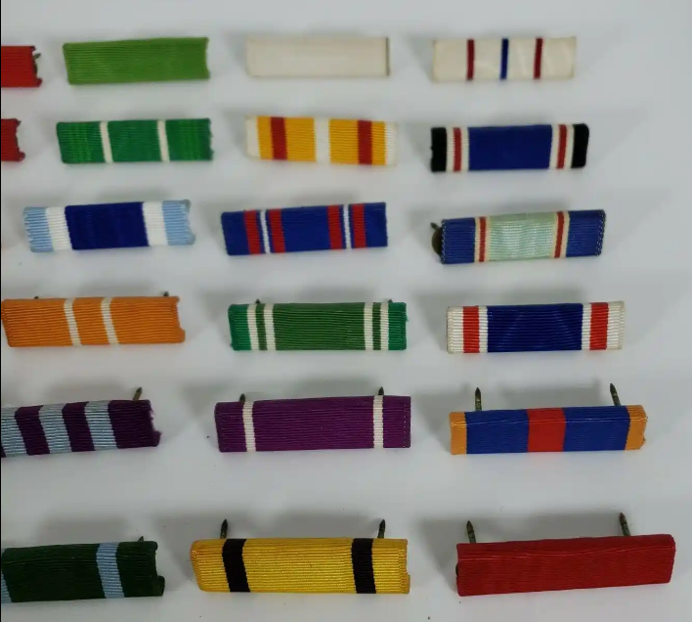
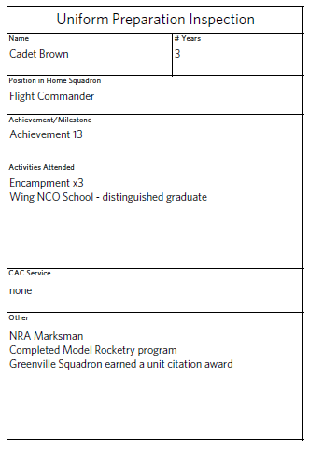
WCC Uniform Build INFO
Given Day of Event:
- Cadet dossier (story, see sample at right)
- Ribbon “Options Photo”
See NCC link examples:
https://www.gocivilairpatrol.com/media/cms/NCC_Uniform_Inspection_Dossiers_6E6EAFFA87032.pdf

Slide 33
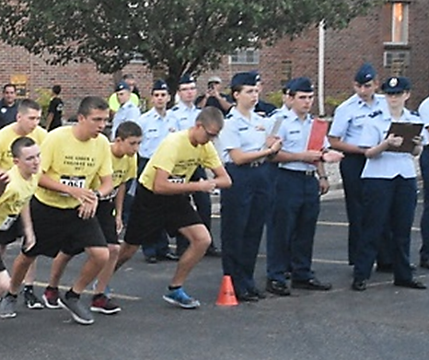
WCC Physical Fitness Test
Objective: This event measures performance in four exercises, both individually and collectively by comparing total scores among teams.

Slide 34
WCC Physical Fitness Test
This event has four exercises
Pacer Run (all six participate)
Push-up (two participate 1:1)
Sit-ups (two participate 1:1)
Sit & Reach (two participate 1:1)
All 1:1 events will be: 1 person selected at random and 1 person selected by the team. Each team will select one person from their team for each 1:1 event. The other three non-selected cadets will be randomly assigned.

Slide 35
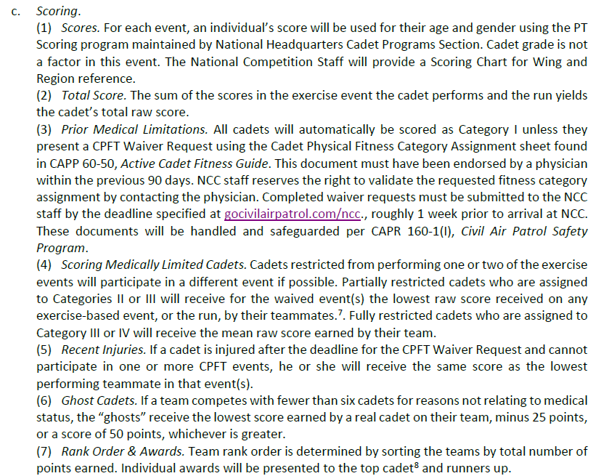
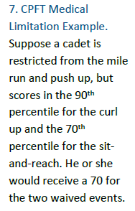

Ghost Cadets & PT Restricted Cadets
Page 16

Slide 36
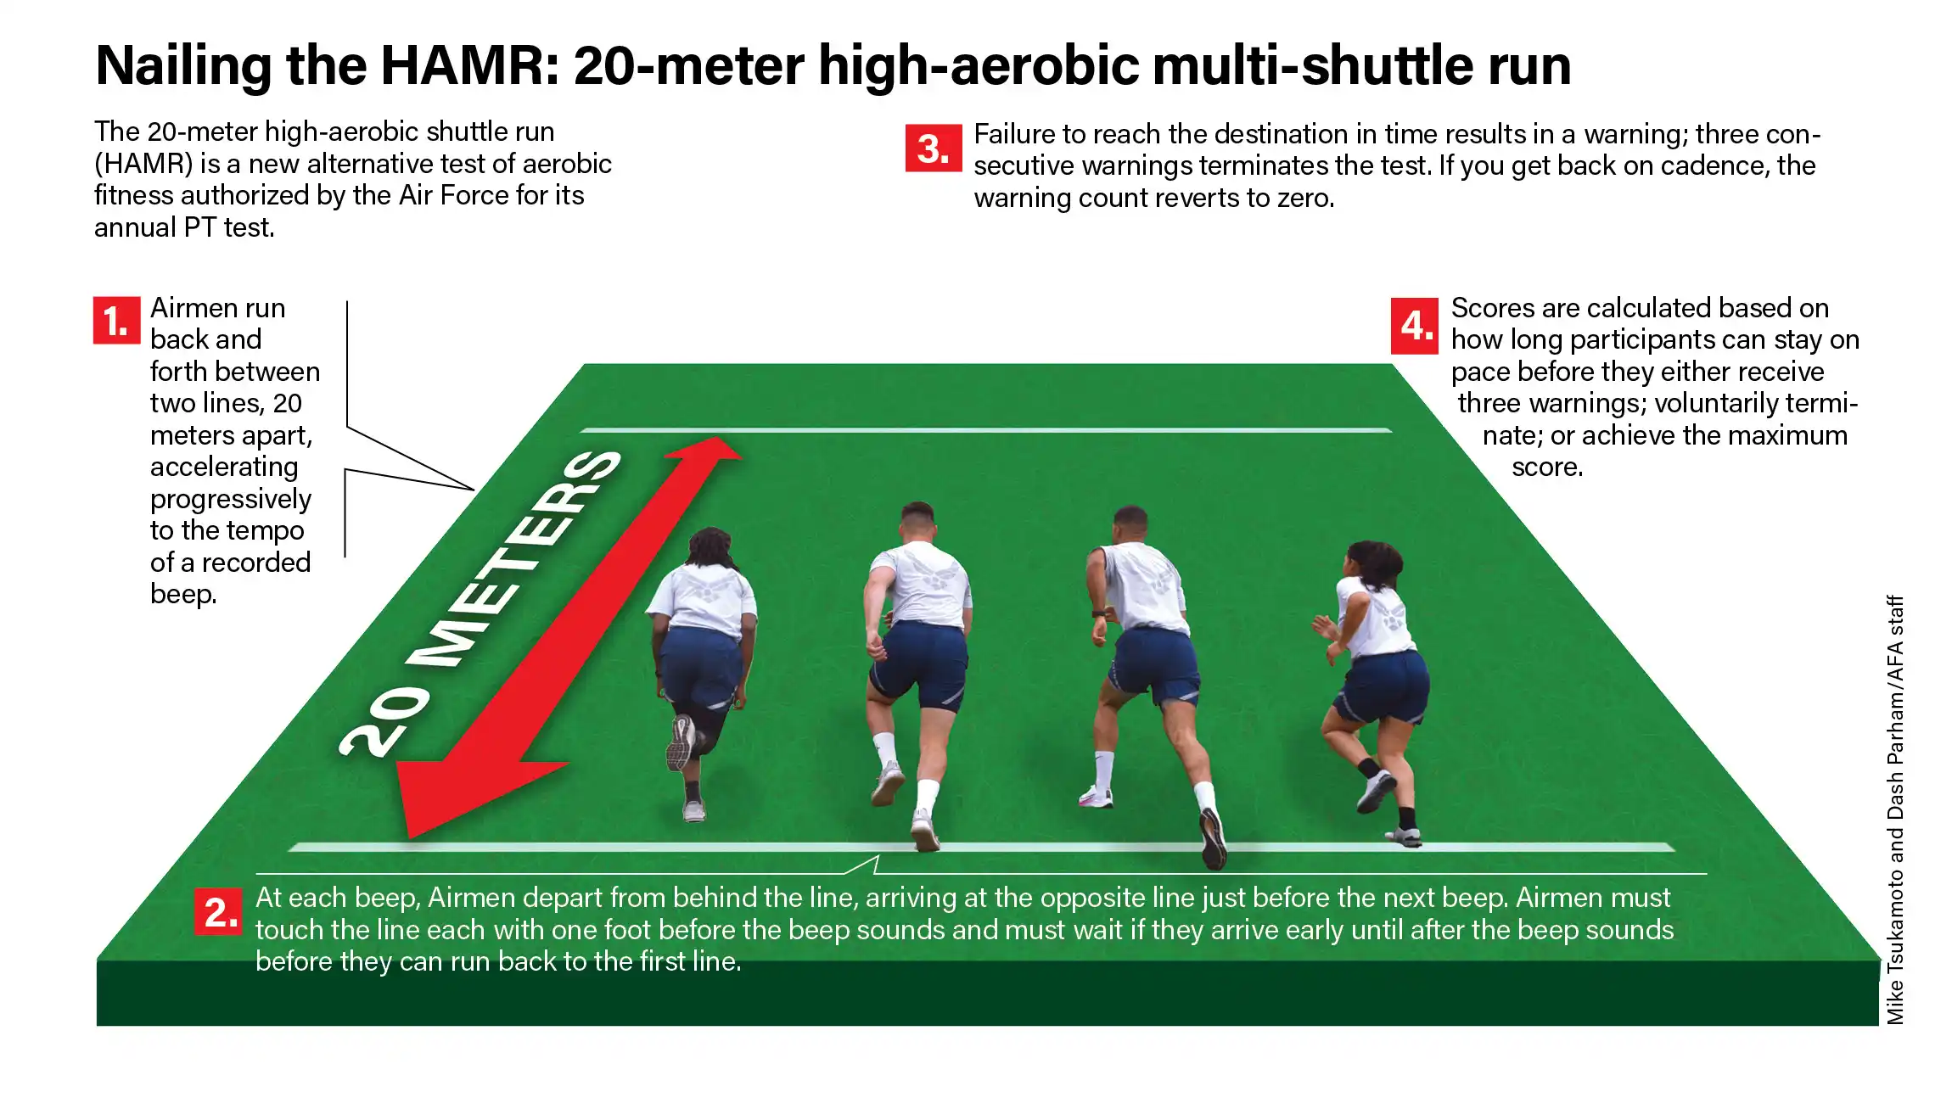
PACER Run

Slide 37
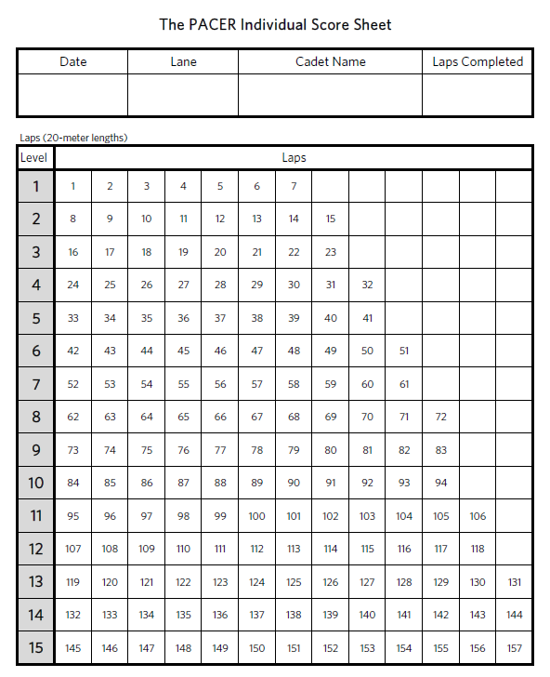
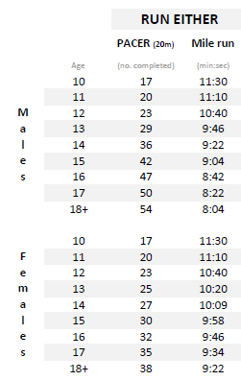
100%
46
58
72
84
94
94
94
100%
46
50
54
60
64
64
64

Slide 38
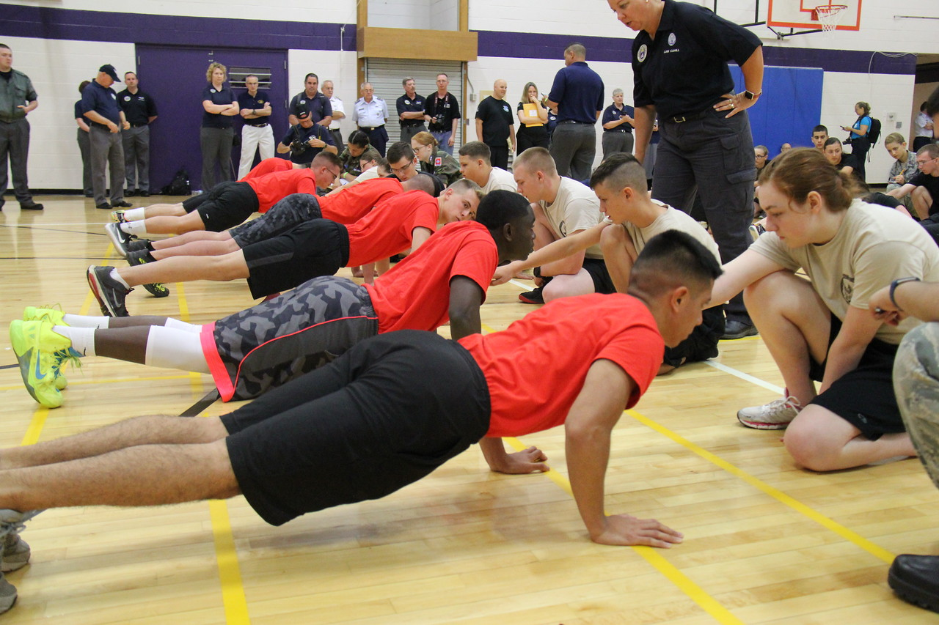
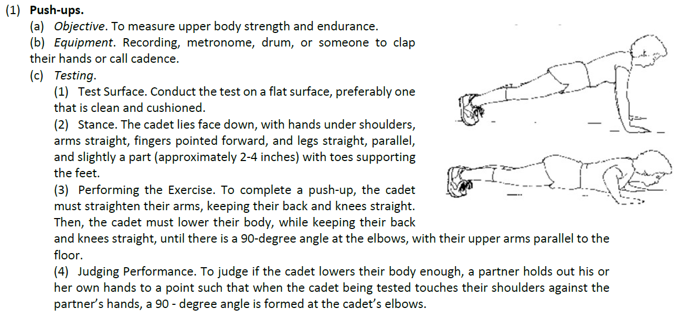
Push-up’s
16pg

Slide 39
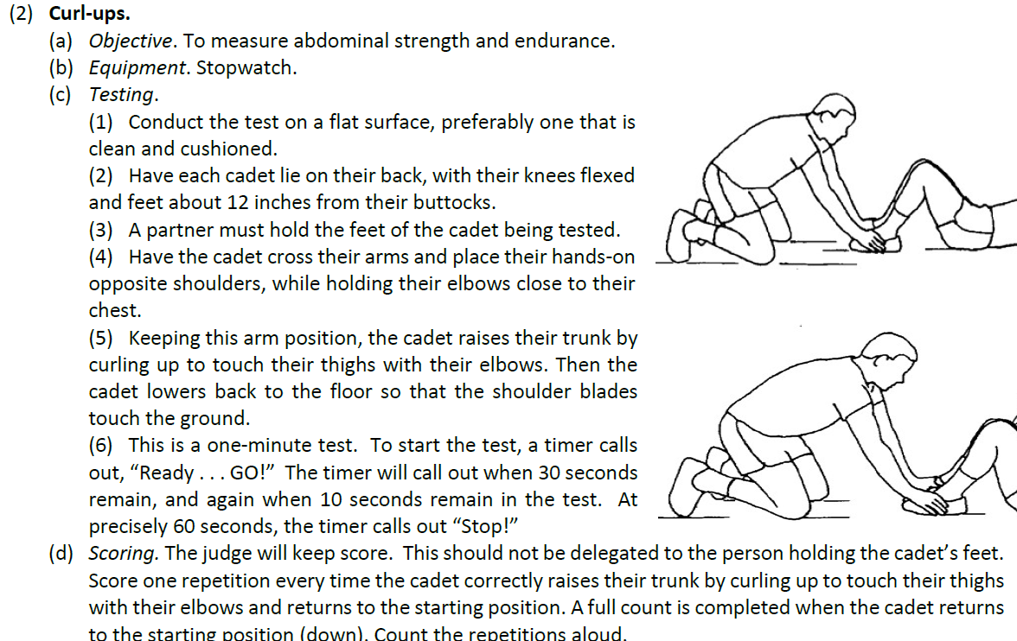
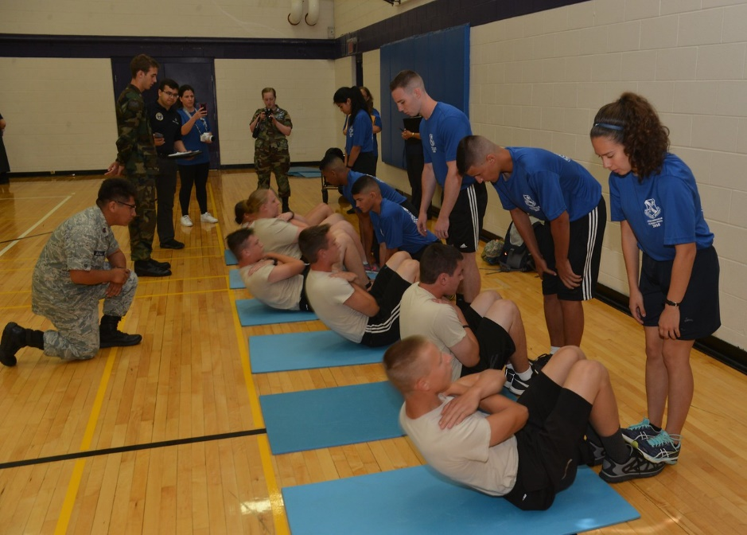
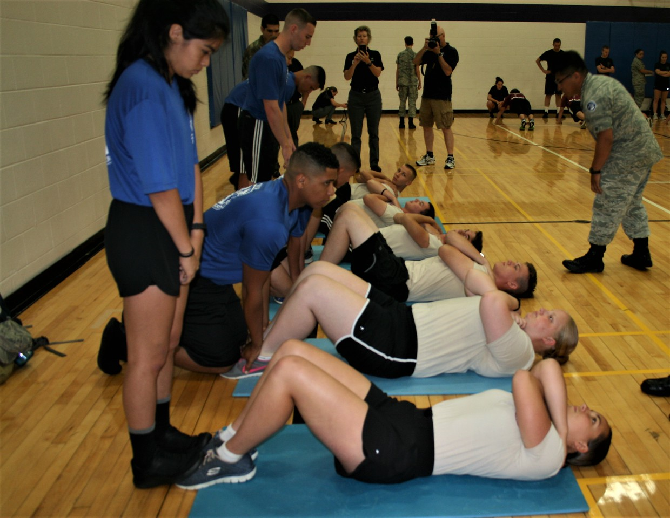
Curl-up

Slide 40
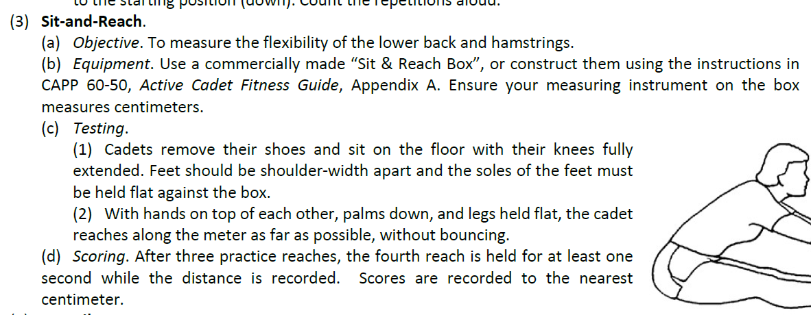
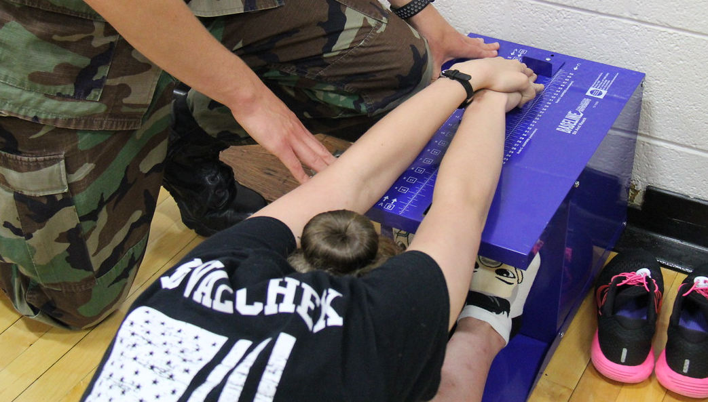
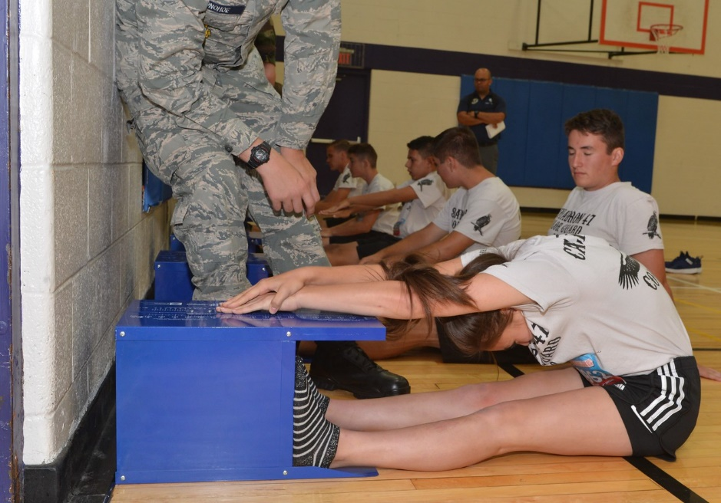
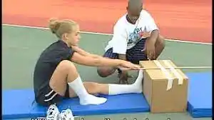
Sit & Reach

Slide 41
Written Exam
Objective: The written exam is a test of academic knowledge in the fields of leadership and aerospace, both on an individual basis and collectively by comparing total scores among teams.

Slide 42
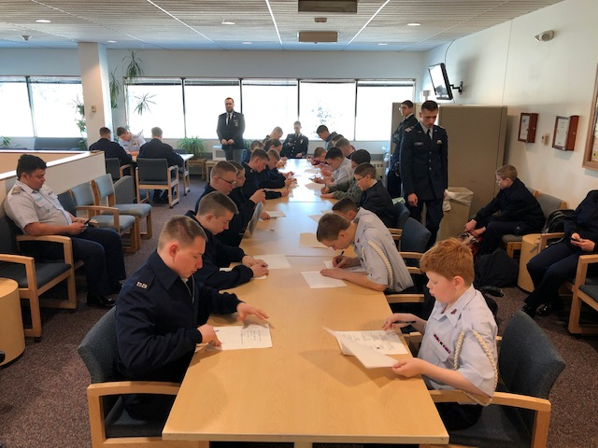
WRITTEN EXAM
50 Multiple Questions Test
- 50 minutes & Closed Book -
  22 Leadership (L2L 1&2 )
  22 Aerospace (3rd edition Modules 1-7)
  4 Drill (AFMAN 36-2203, Chapters 1-4 )
  2 Aerospace Current Events*
  (*CAP or Aerospace events of national significance in the last 6 months)

Slide 43
WRITTEN EXAM
  Online Test
    All teams will log–in via link sent to their Wing Google Email and take the test.
    Teams with no/limited internet access will have the written test mailed to them
    (prior arrangements required)
    - Cadets with Special Needs
    see: CAPP 60-75 page 14
Ghost Cadets:
If a team has fewer than a full team of six cadets testing, the “ghost” cadets receive the lowest score earned by a real cadet on their team, minus 20 points, or a score of 20 points, whichever is greater.
CAPP 60-75 page 14

Slide 44
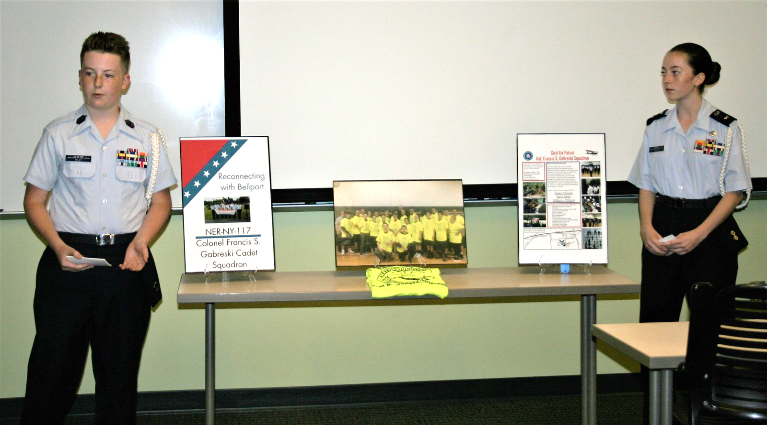
Pre-Competition Service Project

Slide 45
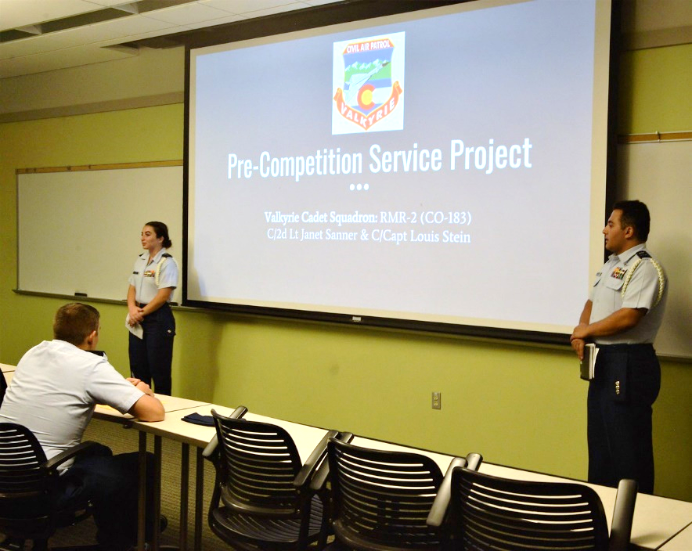
Presentation
- Two cadets represent the team and deliver a pre-planned presentation seated at a table.
Visual Aids
- Max of 7 Visual Aids
- Text-heavy PowerPoint presentations are not permitted. Video and audio files are not permitted.
Time: 10 min
Conclusion Process - Q&A

Slide 46
Service Project Rules
Teams may pick their own speakers. Each speaker must present at least 3 minutes of the presentation. Both will present seated on camera. Teams may wear the Lightweight Blue Jacket (Blues Eisenhower Jacket) while presenting, but receive no bonus from wear this uniform item.
All visual aids must be submitted as a Microsoft Powerpoint file (.pptx) to Cadet Competition Staff two days before.

Slide 47
Service Project Rules
Second Teams
  May present on same project as the primary teams. However, 5 of the 7 visual aids must be different and provide additional information about the project that the first team did not present.
Combo Teams
  Must present on both squadrons’ service projects and will be allowed 5 extra minutes and 5 more visual aids (15 min & 12 visual aides). One member from each squadron must present their own squadron’s project.

Slide 48
Service Project Rules
Incomplete Service Project:
If teams have not been able to complete a service project before the competition, the WCC Activity Director may approve a presentation on a service project planned to take place after the cadet competition. There will be a reduction in points on some scoring categories due to non-completed project.

Slide 49
Jeopardy or Knowledge Quiz
Objective: This event requires teams to hit the books prior to competition. Cadets will show their knowledge of aerospace & leadership.
The quiz is a Kahoot! event where you will pit your team’s knowledge against all other teams.

Slide 50
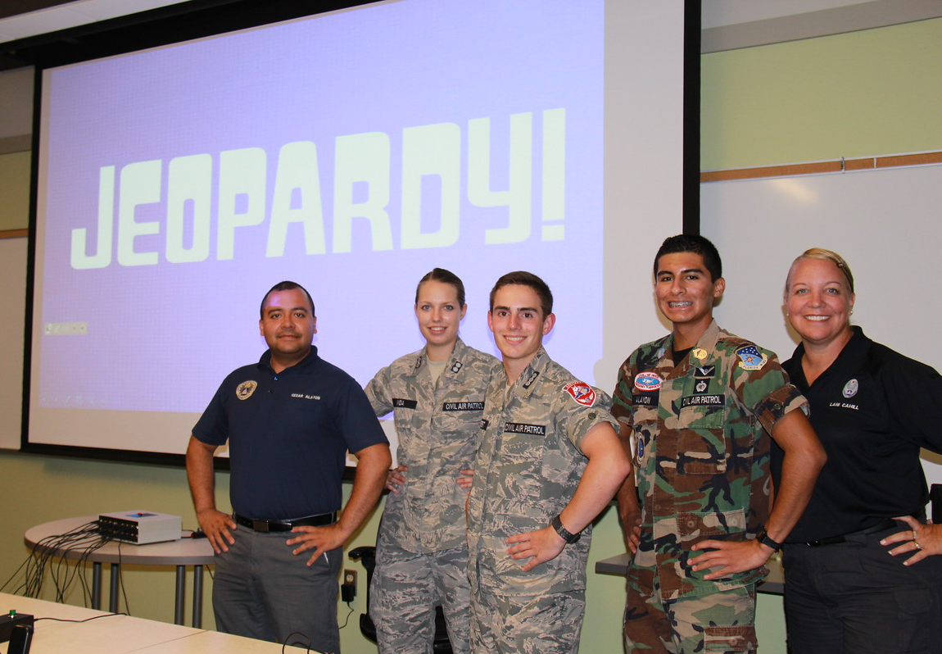

Jeopardy or Knowledge Quiz

Slide 51
Jeopardy: Methods & Controls
Kahoot’s assignment link will be given to the team and they will be FaceTime/web video judged during the quiz.
All questions will be answered in a team cycle. For example, a cadet cannot attempt to answer a second question until all cadets on the team have attempted to answer one question.
Once the cycle has started, the sequence of cadets cannot be changed, passed or substituted. Each person must attempt to answer their own question without input from other team members.

Slide 52
Questions will be from:
- L2L Chapters 1-8
- Aerospace Modules 1-7
- New Cadet Guide
Total of 30 Questions
30 min to complete the quiz

Slide 53
Reporting in
Report in as:
  Cadet/Rank/Name/Squadron Number
  C/SSgt./Smith/081- Reporting for:
  Indoor Posting (In only)
  Uniform Prep (Build) (In & out)
  Service Project Presentation (In & out)
  Report Not Scored
    Element Drill
    Standard Colors Drill
No need to report for:
- Team Leadership Problem
- Physical Fitness Test
- Panel Quiz/Trivia
- Written Exam

Slide 54
How Do you Win?
Score & Score Cards

Slide 55
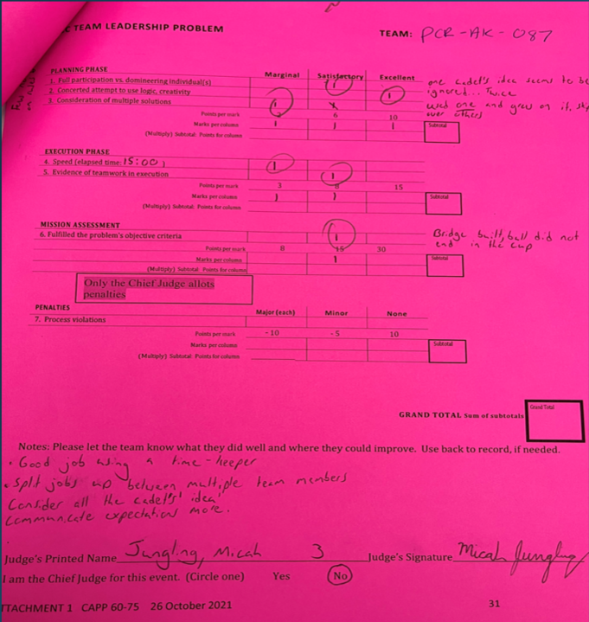
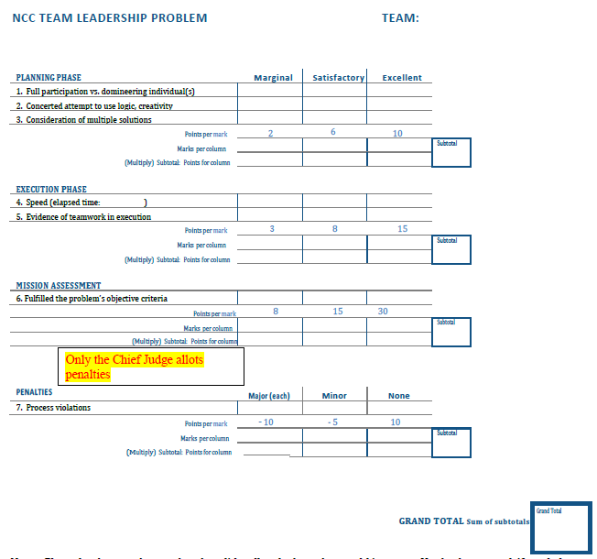

Slide 56
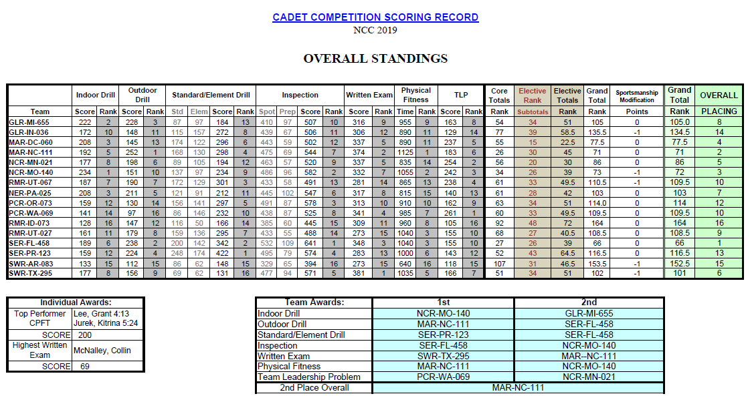
Max possible Score 300 [3x] 300 [3x] 270 270 [3x] 600x2 150 [3x] 420 [C/ 6] 1190 [2x] 280 [3x]

Slide 57
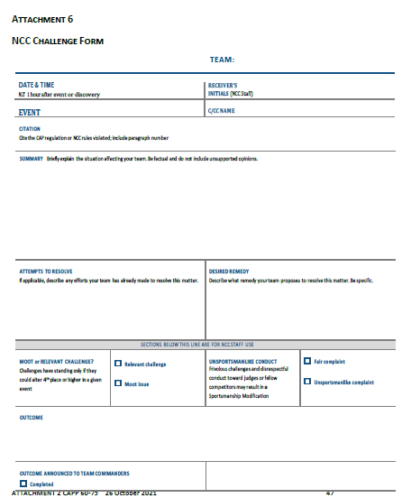
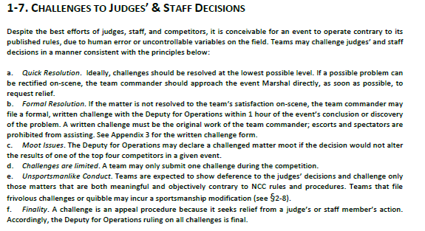
Challenge FORM
All Challenge form’s must be turned into the Cadet Competition Cadet Commander with-in two hours of the time you received the copy of the judging sheet.
Competition Director
Competition Director
Competition Director’s
CAPP 60-75 page 7

Slide 58
Sportsmanship Modification

Slide 59
Seniors Members Roles
Each Team will have Two Senior Member (SM) Escorts, one of whom should have a valid CAP Driver’s License as indicated in eServices (pls check yours)
SM escorts may help before but not during the competition. Senior voices must not be heard during the competition.
SM escorts may ask questions before or after but not during the competition.
All discussions and questions will be with/by the Cadet Team Leader
Judges will announce the start and stop of the Virtual Competition environment.
A Penalty will be awarded for each time non-cadet voices are heard.

Slide 60
Schedule Of 2024 Competitions
Alaska Wing Competition
  Saturdays 25th Nov & 2rd Dec 2022
Pacific Region Competition
  TBD CA or NV 22-24 March 2024
National Competition
  TBD 18-22 July 2024 in Dayton, OH
  (https://www.gocivilairpatrol.com/programs/cadets/activities/national-cadet-competition)

Slide 61

Any Questions?
Please send all Questions to CP@AKWG.CAP.GOV
https://akwg.cap.gov/programs/cp/activities/22cc

