Slide 1
Alaska Wing Command and Staff Meeting
Col Kevin McClure, CAP
AKWG/CC
06 Jul 23
Volunteers serving America’s communities, saving lives, and shaping futures

Slide 2
ROLL CALL
SQUADRONS | AK-087 Kodiak | Maintenance
AK-001 Alaska Wing | AK-091 Gateway | Public Affairs/Communication
AK-009 Fairbanks | AK-093 Lake Hood | Inspector General
AK-011 Kenai | Bethel Flight | Administration
AK-015 Polaris | Homer Flight | Development
AK-017 Arcturus | WING STAFF | Cyber Security
AK-022 Southeast | AKWG/CV | Chaplain
AK-027 Delta | Chief of Staff | Judge Advocate General
AK-068 Bristol Bay | Operations | Finance
AK-071 Eielson | Cadet Programs | Diversity
AK-072 Valdez | Aerospace Education | Compliance
AK-076 Birchwood | Personnel/Education/Training | Safety
AK-085 Tok | Logistics/Transportation/Supply | Wing Administrator
 | Historian | CAP-USAF/ROD

Slide 3
PLEDGE OF ALLEGIANCE
I pledge allegiance to the Flag of the United States of America, and to the Republic for which it stands, one Nation under God, indivisible, with liberty and justice for all.

Slide 4
AKWG/CC’s Seven (Strategic) Priorities 2022-2023
Ensure the Health & Safety of All Members In An Inclusive, Diverse
Organization Fostering Our Core Values Within A Culture of Compliance
Increase Impact of All Unit-Level Fundraising; Pursue Grants At Every Level
Enhance Recruiting, On-Boarding & Retention In Order to Develop Every
Member (and Build Our Organization’s Future) via Effective Mentoring
Ensure CC’s Have SCC & Units Increase Their Mission Capability By Growing ICS, Aircrew and Ground Team Personnel by 25%
Ensure All CC’s With Cadets Have Completed TLC; 80% Meet QCUA
Criteria; Exceed PCR O-Flt Goals; Increase Cadet Flt & ES Training
6. Continue AE Internal Development & External Outreach Programs With A Focus
On AEX/STEM Enrollment/Completion (All Units Complete 1 in FY22)
Expand Partnerships with USCG, USCG Aux, NG/ANG, SOA

Slide 5
CC’s UPDATE
Recurring Compliance Guidance
- Unit CCs Required to Upload Compliance Documents By End of January
each year
- Staff Directorates Required to complete Compliance Documents By End of
January and By the End of July Each year, and send to CAP Admin Officer
To Remind: Consider Working In “Core Values for Senior Members” CAPP 80-3 In This Quarter’s Training plan
Please Invite Members to Consider Filling AKWG Staff Vacancies
(See AKWG Homepage or 13 Oct 21 eMail or Details )

Slide 6
FY23 ENACTED BUDGET
$250K for AKWG appears on page 31, line 12 of HB281 FY2022/FY2023 Operating, Capital, Supplemental Bill (see above)
https://omb.alaska.gov/fiscal-year-2023-enacted-budget/
Unit Commanders Should No Later Than 31 July 2022:
1. Prepare for Utilities to Be Paid for By AKWG out of State Grant Funds
FOR FY23 Only
-- We’ll Watch To See If the AK State Grant Continues in FY24
2. Prepare and Submit a Facility & Equipment “Wish List” for Action in
August 2022 (Upon Verification of State Funds in AKWG Accounts)
POC: Capt Aldridge, taldridge@gci.net
AKWG Directors Should No Later Than 31 July 2022:
Prepare and Submit an Equipment and Operation/Activity “Wish List”
for Action in August 2022 (Upon Verification of State Funds)
POC: Capt Aldridge, taldridge@gci.net

Slide 7
AKWG POSITION VACANCIES
The following Wing Command & Staff Positions are vacant and accepting applications from Alaska Wing members:
Commander, AK-93 (Lake Hood)
Commander, AK-22 (Southeast – starts May 2023)
Public Affairs, Assistant – Social Media
Supply Officer
Development Officer
Wing NCO Advisor
Command NCO
Interested members are encouraged to review CAPP 30-1 for job descriptions, and then apply by submitting their Resume and Letter of Intent via email to CC Colonel Kevin McClure

Slide 8
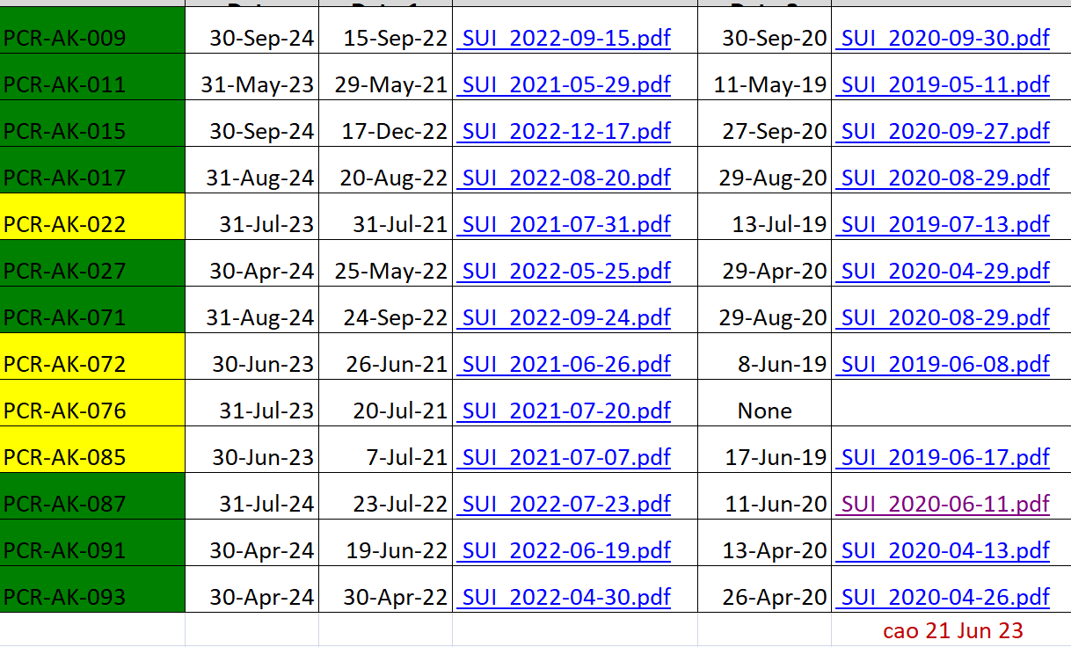
SUI DUE DATES

Slide 9
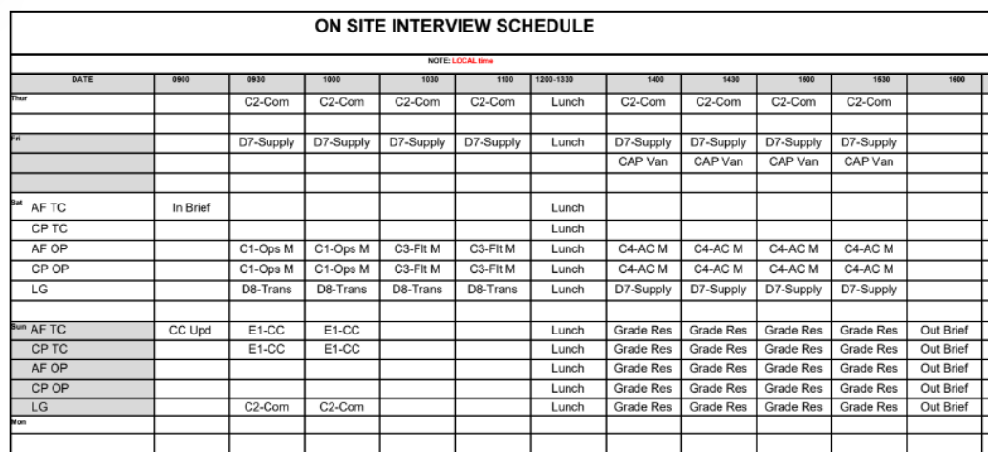

Slide 11
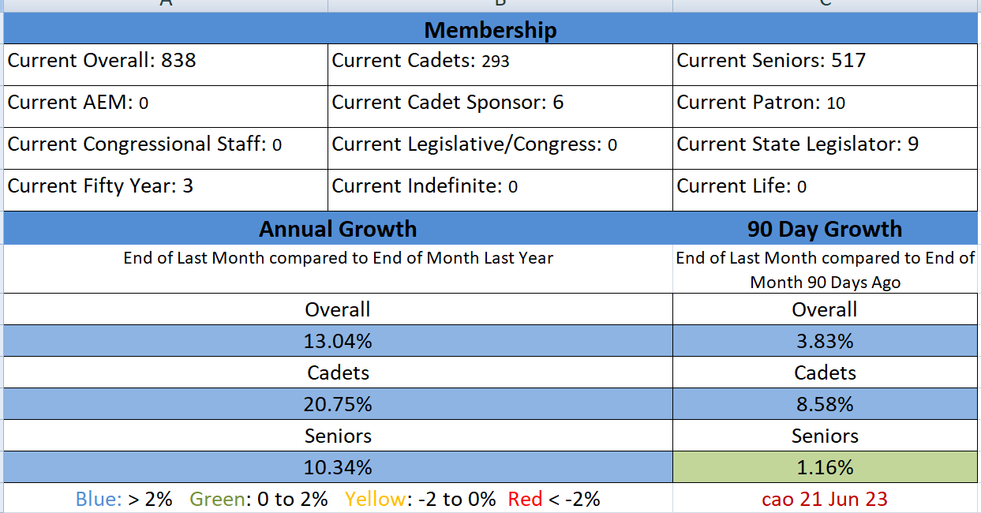
Wing Metrics: Membership
OVERALL, LEVELING OFF; CONT INCR IN CADETS – MAKE SURE YOU ARE TAKING CARE OF YOUR CURRENT CADETS

Slide 12
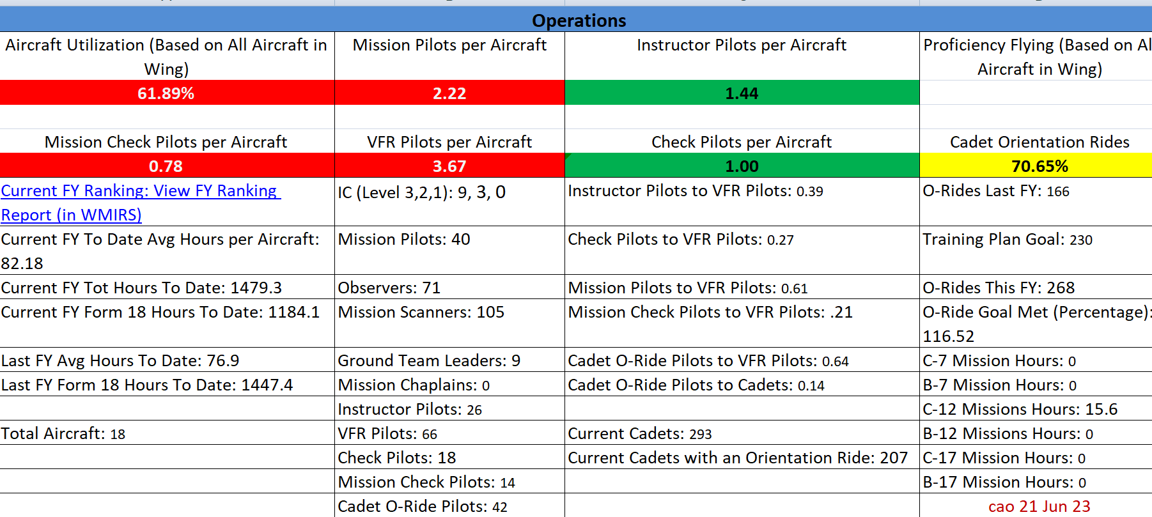
Wing Metrics: Operations
INCREASE IN HRS & INSTRUCTORS, NEED MORE
MP’s & VFR PILOTS AND O’FLTS!

Slide 13
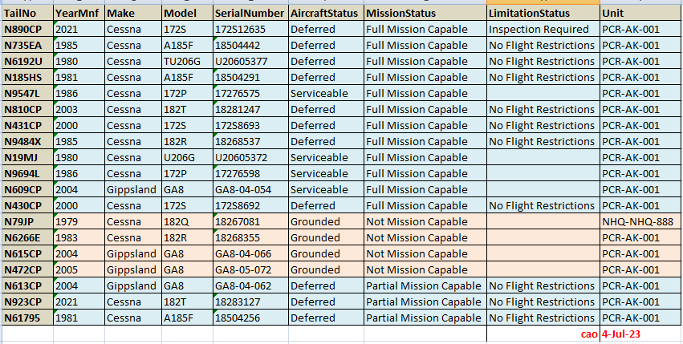
Aircraft Maintenance Status

Slide 14
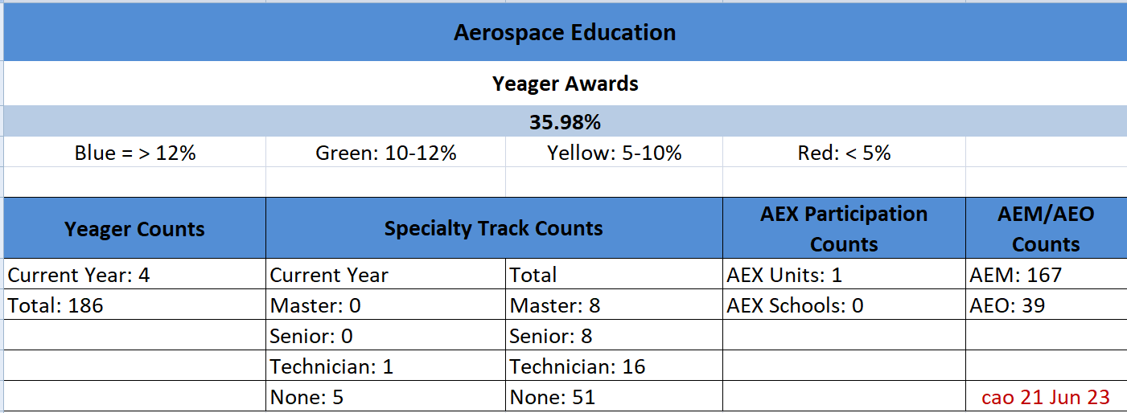
Wing Metrics: Aerospace Education
AEX – Aerospace Education Excellence
AEO – Aerospace Education Officers
AEM – Aerospace Education Members

Slide 15
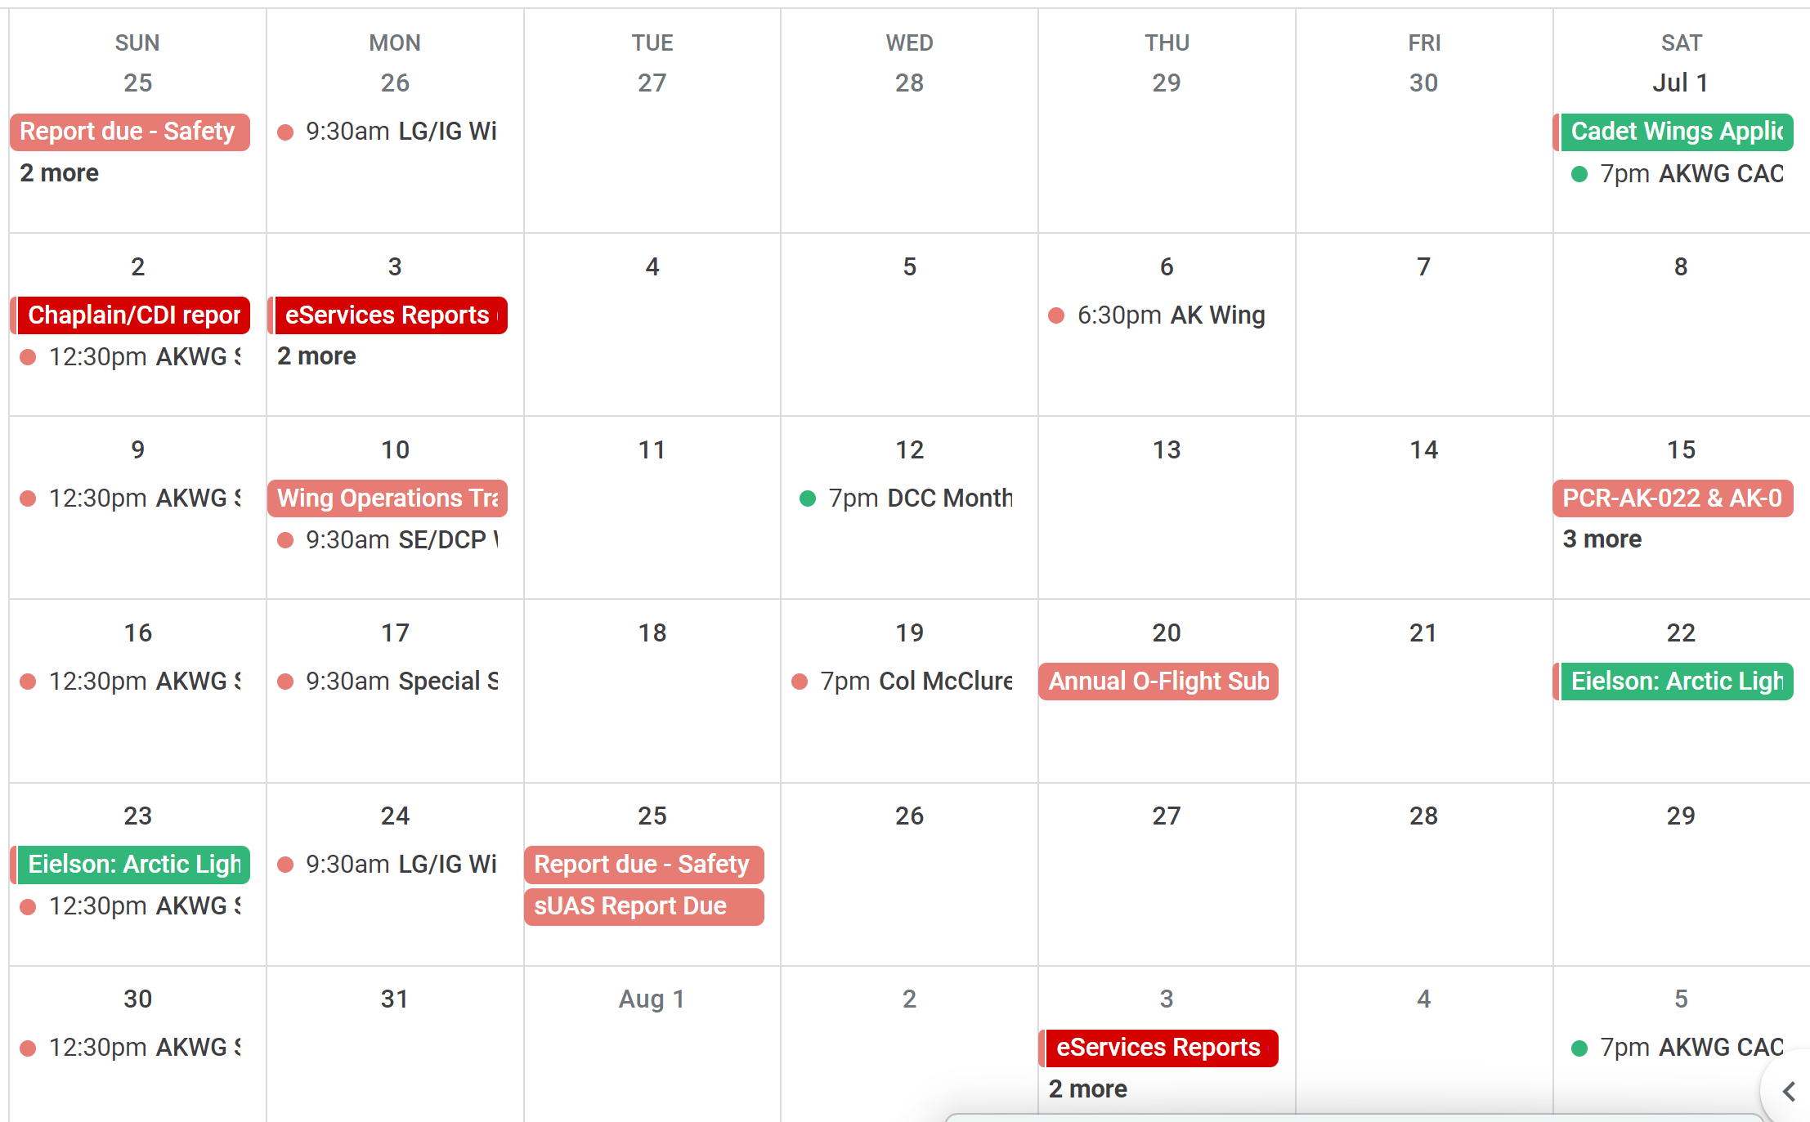
JUL 2023 Wing Calendar
http://www.akwg.cap.gov/

Slide 16
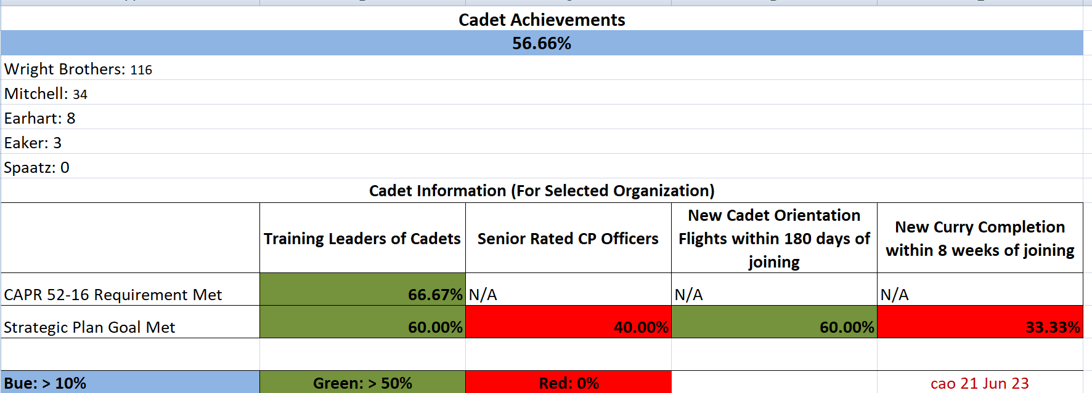
Wing Metrics: Cadet Programs
Must have at least 2 SMs with TLC in last 4 years to be in compliance.
To retain our ~300 cadets, get them to Curry within 8 weeks

Slide 17
CADET PROGRAMS AKWG/DCP, Capt Karen Padgett
Upcoming Activities (also see AKWG Calendar)
7/12/23, 7-8pm Wed—Next CP Officers Monthly Chat & Checkin (Google aak-zpnn-ajn)
7/1/23-9/30/23—CADET WINGS scholarship application window NOW OPEN!*
Summer 2023—29 AKWG cadets & 4 SMs slotted for National Cadet Special Activities
8/31/23—Pick.Click.Give final date to select AKWG CAP Cadet Programs
10/7/23—Wing Conference including cadet activities!
11/25/23 & 12/2/23—Wing Cadet Competition (POC Capt Ed Stickel)
To retain our 298 cadets, get them to Curry in 8 weeks! And get CP Tech Rating for your SMs
Recent Accomplishments
5/26-6/4/23—Glider Flight Academy at Clear SFB Complete—17 students,
6/18-24/23—Encampment Complete—57 1st-time, 21 Adv students, 29 cadet staff
AKWG Powered Flight Academy (Distributed) complete—1 cadet soloed
2 AKWG cadets received Private Pilot’s Licenses (C/Lt Ben Walkup & C/Maj Mitch Anderson)
cao 3Jul23kp Pick.Click.Give to Alaska Civil Air Patrol Cadet Programs

Slide 18
CADET PROGRAMS AKWG/DCP, Capt Karen Padgett
Cadet Wings Flight Instruction Funding
Funding for up to 60 hr/$15,000 flight instruction)
Steps/instructions available here: https://akwg.cap.gov/programs/cp/flighttraining
7/1/23-9/30/23 application window (rolling acceptance)
Specifically:
Student Pilot Certificate *is* considered a “Current pilot certificate” (get IACRA numbers)
Pass Written Test (complete free Sporty’s ground school & $60 Dauntless test bank practice tests)
Class 3 or better medical (Schedule their MedXPress medicals!)
Coordinate with their Ray Navigators (Any SM mentor) & proposed instructors
Get letters of recommendation from current instructors
Draft their flight training “flight plan” (ideally with a flight school, not CAP instructors)
cao 3Jul23kp Pick.Click.Give to Alaska Civil Air Patrol Cadet Programs

Slide 19
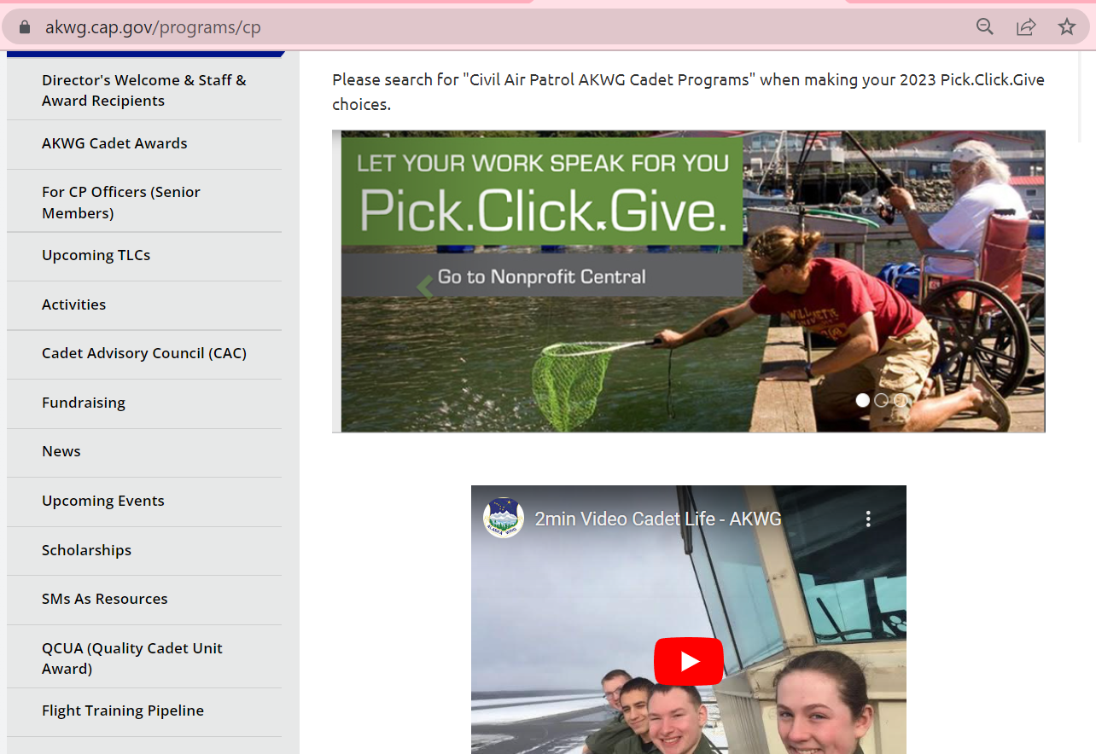
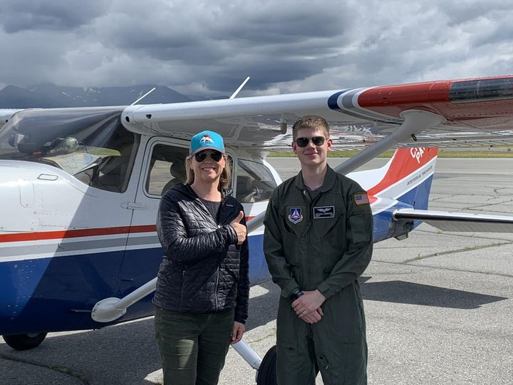
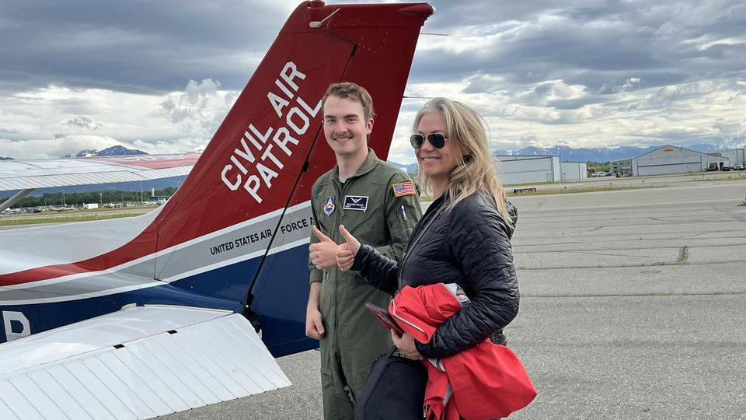
CADET PROGRAMS
Recent PPLs C/Maj Anderson & C/Lt Walkup, June 2023

Slide 20
SQUADRON CCs REPORT
AK-009 Fairbanks AK-011 Kenai
AK-015 Polaris AK-017 Arcturus AK-022 Southeast AK-027 Delta
AK-068 Bristol Bay AK-071 Eielson
AK-072 Valdez
AK-076 Birchwood
AK-085 Tok
AK-087 Kodiak AK-091 Gateway
AK-093 Lake Hood
Bethel Flight
Homer Flight

Slide 21
Logistics and Transportation
Short Report on vehicle movements/transfers.

Slide 22
STAFF REPORTS
LG (Transpo, Supply) – Lt Clinton Justus
LGM – Lt Col Tom Palmer
PAO/COM – Lt Col Bryan Emerson
IG – Lt Col Gene Moyer
Personnel/Prof Dev – Lt Col Al Senese
HC – Ch, Maj. Kevin E. Bottjen
JAG – Lt Col Stuart Goering
FM – Capt Terry Aldridge
ES/HSO – Lt Col Sammons
AO/Historian – Lt Mary Stella
Diversity/Rec-Ret - Lt Elizabeth Justus
Development – VACANT
Compliance – Col Staats
SE – Capt Burand II
Com NCO – VACANT

Slide 23
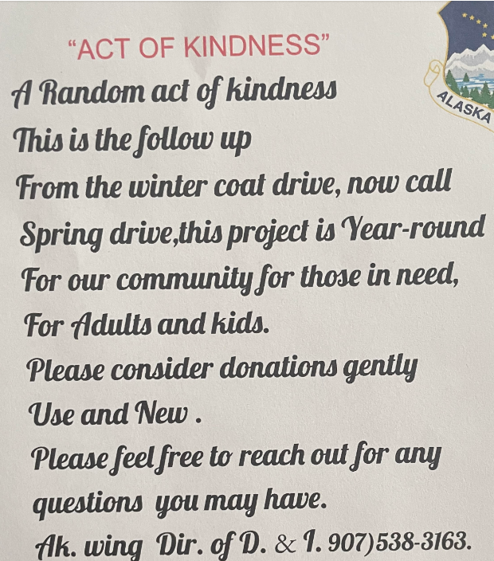

Slide 24
SAFETY
Safety sign in link for Attendance Credit
http://apps1.akwg.cap.gov/meeting_attendance.php

Slide 25
CAP-USAF
Lt Col Nate Healy

Slide 26
COMMENTS & QUESTIONS
Col McClure’s “Open Mike Night”
Every third Wednesday of month at 7:00 pm (1900)
Save the date 6, 7, 8 Oct 2023
Wing Conference

